Slide 1
JavaScript

Slide 2
Course Evaluation
55 % assignments from each topic and presentation
15% participation
5% attendance
25% quizzes(5), mid(10), final(10) Upon completion, students will receive a certificate of Accomplishment.

Slide 3
Module 1: Introduction to JavaScript
1. What is JavaScript?
2. JavaScript's role in web development
3. Setting up the development environment
4. Basic syntax and structure
5. Variables and data types
6. Comments and best practices
Module 2: Control Flow and Functions
1. Conditional statements (if, else if, else)
2. Switch statements
3. Loops (for, while, do-while)
4. Functions: declaration, invocation, and parameters
5. Scope and variable visibility
6. Return statements and value passing
Table of Contents

Slide 4
Module 3: Data Structures
1. Arrays: creation, manipulation, and iteration
2. Objects: properties, methods, and object literals
3. Working with JSON data
4. Iterators and generators
Module 4: Working with the DOM (Document Object Model)
1. Introduction to the DOM
2. Selecting and manipulating elements
3. Modifying element content and attributes
4. Creating and removing elements
5. Event handling and listeners
6. Bubbling and delegation
Table of Contents

Slide 5
Module 5: Asynchronous JavaScript
1. Introduction to asynchronous programming
2. Callback functions
3. Promises: creation, chaining, and error handling
4. Fetch API for making HTTP requests
5. Async/await syntax
6. Working with timers (setTimeout, setInterval)
Module 6: Error Handling and Debugging
1. Understanding common JavaScript errors
2. Using the browser's developer tools
3. Debugging techniques and breakpoints
4. Handling exceptions with try...catch
5. Console methods for debugging
Table of Contents

Slide 6
Module 7: Advanced JavaScript Concepts
1. Closures and lexical scope
2. Hoisting and variable declaration
3. The 'this' keyword and context
4. Prototypes and inheritance
5. ES6+ features: let, const, arrow functions, classes, etc.
Module 8: JavaScript Modules
1. Modular programming and code organization
2. CommonJS vs. ES6 Modules
3. Exporting and importing modules
4. Managing dependencies with package managers (npm, yarn)
Table of Contents

Slide 7
Module 9: Browser APIs and Client-Side Storage
1. Working with the window object
2. Browser events and event propagation
3. LocalStorage and SessionStorage
4. Cookies and their limitations
5. Manipulating the browser's history
Module 10: Security and Best Practices
1. Cross-Site Scripting (XSS) and Cross-Site Request Forgery (CSRF)
2. Sanitizing user input
3. Securing API keys and sensitive data
4. Performance optimization tips
5. Code formatting and linting
Table of Contents

Slide 8
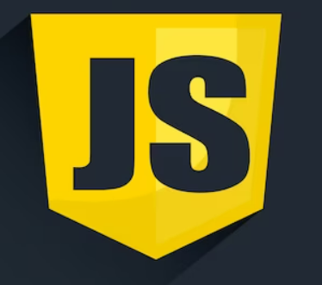
Introduction to JavaScript
JavaScript is a foundational programming language for building modern web applications with dynamic, interactive, and user-friendly features. Its versatility, compatibility, and thriving ecosystem make it a cornerstone of web development.
JavaScript plays a crucial role in client-side scripting, which means it runs directly in a user's web browser. It's used to enhance the interactivity and functionality of web pages, enabling developers to create dynamic content that responds to user actions without requiring a full page reload.

Slide 9
Introduction to JavaScript
Key Features and Use Cases
Manipulating HTML and CSS: JavaScript can modify the content and styles of HTML elements, allowing developers to create animations, toggle elements, and update information on the page in real-time.
Event Handling: JavaScript enables the creation of event listeners that respond to user interactions like clicks, keyboard inputs, and mouse movements. This allows developers to build interactive interfaces.
Asynchronous Programming: JavaScript supports asynchronous operations, which is crucial for tasks like fetching data from servers, making API calls, and updating the page without blocking other processes.

Slide 10
Introduction to JavaScript
DOM Manipulation: The Document Object Model (DOM) represents the structure of a webpage. JavaScript provides the ability to access, manipulate, and modify the DOM, enabling dynamic content updates.
Form Validation: JavaScript can validate user inputs in forms before they're submitted to a server, providing instant feedback to users.
Browsers Compatibility: JavaScript is supported by all modern web browsers, making it a versatile choice for building cross-platform applications.
Server-Side Development: While JavaScript is primarily known for client-side scripting, it's also used on the server side. Technologies like Node.js enable developers to use JavaScript for building server applications, handling network requests, and managing databases.

Slide 11
Introduction to JavaScript
Client-Side Scripting:
JavaScript is primarily executed on the client side, which means it runs directly in a user's web browser. This enables developers to create applications that respond to user interactions without needing to communicate with the server for every action.
Some key aspects of JavaScript's role in client-side scripting include:
Dynamic Content: JavaScript enables developers to manipulate the Document Object Model (DOM) of a webpage. This means you can change, add, or remove elements on a webpage dynamically without requiring a full page reload.

Slide 12
Introduction to JavaScript
Event Handling: JavaScript lets you set up event listeners that respond to user actions like clicks, form submissions, and key presses. This interactivity enhances the user experience and makes web applications feel more like desktop applications.
Form Validation: JavaScript can validate user inputs in forms before they're submitted to the server, ensuring data integrity and providing immediate feedback to users.
Animations and Effects: With JavaScript, you can create animations, transitions, and visual effects that engage users and provide a polished feel to your application.

Slide 13

Introduction to JavaScript
Setting up the Development Environment
Step 1: Install Visual Studio Code
If you haven't already, download and install Visual Studio Code from the official website. It's available for Windows, macOS, and Linux.

Slide 14
Introduction to JavaScript
Step 2: Install Extensions
Extensions enhance the functionality of VS Code. Here are some essential extensions for JavaScript development:
ESLint: Integrates ESLint to enforce coding standards and catch errors.
Prettier: Integrates Prettier for consistent code formatting.
Debugger for Chrome: Allows debugging JavaScript code in Google Chrome.
Live Server: Sets up a local development server for testing HTML and JavaScript.
Node.js Extension Pack: Includes extensions for working with Node.js.(https://nodejs.org/en/download )
To install extensions:
Open VS Code then click on the Extensions icon in the sidebar.

Slide 15
Introduction to JavaScript
Step 3: Create a Project Folder
Create a folder for your JavaScript project where you'll store your code files.
Step 4: Open Your Project in VS Code
Open your project folder in VS Code by selecting File > Open Folder and navigating to your project directory.
Step 5: Create a JavaScript File
Create a new JavaScript file with a .js extension in your project folder. You can do this by right-clicking in the file explorer and selecting "New File," then giving it a name like app.js.

Slide 16
Introduction to JavaScript
Step 6: Write Your JavaScript Code
Open the app.js file and start writing your JavaScript code using the integrated code editor.
Step 7: Use Extensions
Formatting Code: Use the Prettier extension to automatically format your code. You can configure formatting rules in your VS Code settings.
Linting: The ESLint extension will highlight issues and errors in your code according to your ESLint configuration.
Debugging: Use the Debugger for Chrome extension to set breakpoints and debug your JavaScript code in the Chrome browser.

Slide 17
Introduction to JavaScript
Step 8: Running JavaScript Code
Using Node.js: Open the integrated terminal in VS Code (Ctrl+ backtick or View > Terminal) and navigate to your project folder. Run your JavaScript file with the command node app.js.
Using Live Server: If you're working with HTML and JavaScript, you can use the Live Server extension to run a local development server for testing.
Step 9: Test and Debug
Use the integrated debugging tools and the browser's developer tools to test and debug your JavaScript code. Set breakpoints, inspect variables, and step through your code to identify and fix issues.

Slide 18
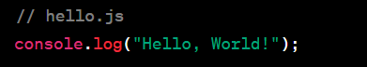
Introduction to JavaScript
Hello, World!:
The console.log() function is used to print messages to the browser's console or the terminal. This simple line of code prints "Hello, World!".

Slide 19
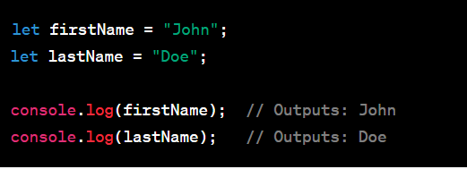
Introduction to JavaScript
Semicolons
semicolons (;) are used as statement terminators. They indicate the end of a statement. However, JavaScript also has a concept called "automatic semicolon insertion" (ASI) that can insert semicolons in certain cases where they are missing. Despite ASI, it's considered good practice to include semicolons explicitly to ensure clarity and avoid potential issues.

Slide 20
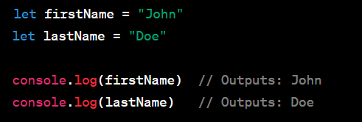
Introduction to JavaScript
Automatic Semicolon Insertion:
JavaScript's ASI automatically inserts semicolons at the end of lines that appear to be the end of a statement. However, relying solely on ASI can lead to unexpected results and bugs.

Slide 21
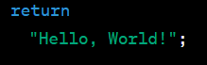
Introduction to JavaScript
Cases Where ASI Can Lead to Errors:
Here, the return statement is followed by a newline, and ASI inserts a semicolon after return, resulting in the return of undefined.
To avoid these issues, it's recommended to use semicolons consistently:

Slide 22
Introduction to JavaScript
Comments and their types
Comments in programming serve as explanatory notes within the code that are ignored by the compiler or interpreter. They provide context, explanations, and documentation for developers.
In JavaScript, there are two main types of comments:
1. Single-Line Comments: Single-line comments are used for adding comments on a single line of code. They start with // and continue until the end of the line.

Slide 23
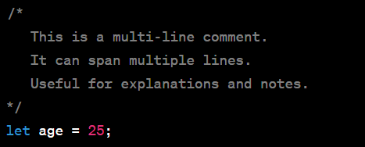
Introduction to JavaScript
2. Multi-Line Comments:
Multi-line comments are used for adding comments that span multiple lines. They start with /* and end with */.

Slide 24
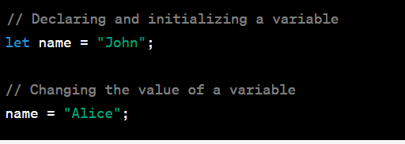
Introduction to JavaScript
Variables:
Variables are used to store and manage data in a program. They provide a way to give names to values so that you can refer to them later. In JavaScript, you can declare variables using keywords like var, let, or const.
Declaration and Assignment:

Slide 25
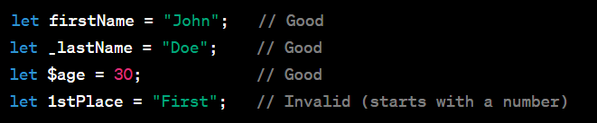
Introduction to JavaScript
Variable Names:
Variable names must start with a letter, underscore, or dollar sign. They can also include numbers, but cannot start with a number. Variable names are case-sensitive.

Slide 26
Introduction to JavaScript
Data Types:
Data types define the type of value that a variable can hold. data types can be broadly categorized into primitive and complex data types.
Primitive Data Types:
Primitive data types are basic building blocks of data in JavaScript. They are immutable, meaning their values cannot be changed once they are created. Here are the primitive data types:

Slide 27
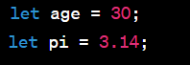
Introduction to JavaScript
1. String:
A sequence of characters enclosed in single or double quotes.
2. Number:
Represents numeric values, including integers and floating-point numbers.

Slide 28
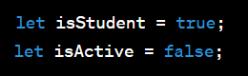
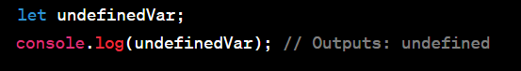
Introduction to JavaScript
3. Boolean:
Represents a true or false value.
4. Undefined:
Indicates that a variable has been declared but not assigned a value.

Slide 29
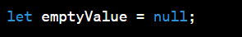
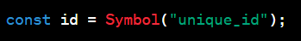
Introduction to JavaScript
5. Null:
Represents an intentional absence of any value or object.
6. Symbol (ES6):
Represents a unique and immutable value, often used as object property keys.

Slide 30
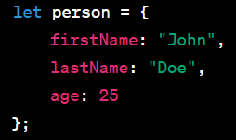
Introduction to JavaScript
Complex Data Types:
Complex data types can hold multiple values and are composed of primitive data types or other complex data types. They are mutable, meaning their values can be changed. Here are the complex data types:
Object: Represents a collection of key-value pairs, where keys are strings and values can be of any data type.

Slide 31
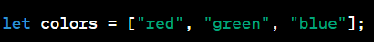
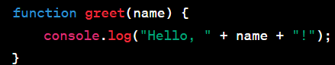
Introduction to JavaScript
2. Array: Represents an ordered list of values enclosed in square brackets
3. Function: Represents a block of code that can be executed..

Slide 32

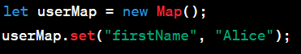
Introduction to JavaScript
4. Date: Represents a specific moment in time
5. RegExp: Represents a regular expression pattern for string matching.
6. Map (ES6): Represents a collection of key-value pairs with more advanced features than objects.
7. Set (ES6): Represents a collection of unique values..

Slide 33
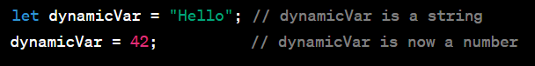
Introduction to JavaScript
Dynamic Typing:
JavaScript is dynamically typed, meaning you don't need to explicitly declare the data type of a variable. The data type is determined based on the value assigned to the variable.

Slide 34
Introduction to JavaScript
Variable and Function Names:
Descriptive Names: Use meaningful and descriptive names for variables and functions that reflect their purpose. This makes your code self-documenting.
Camel Case: Use camelCase for variable and function names. Start with a lowercase letter, and capitalize the first letter of subsequent words.
Constants: Use uppercase letters and underscores for constants.
Abbreviations: Avoid cryptic abbreviations. Choose clarity over brevity.
Plural/Singular Naming: Use plural names for arrays or collections, and singular names for individual items.

Slide 35
Introduction to JavaScript(Exercise)
Exercise 1 - Personal Information
Imagine you are creating a program to store and display personal information about yourself. Use variables and different data types to store various pieces of information. Then, print out a message that includes these details.
Create Variables: Declare variables to store the following information about yourself:
Your full name
Your age
Your hometown
Your favorite color
Whether you are a student (true/false)

Slide 36
Introduction to JavaScript(Exercise)
Assign Values: Assign appropriate values to each variable based on your own information.
Print Message: Use string concatenation or template literals to create a message that includes all the details. Print this message to the console.

Slide 37
Introduction to JavaScript
Operators:
Operators are symbols or keywords that perform operations on one or more operands (values) and produce a result. JavaScript has various types of operators:
1. Arithmetic Operators : These operators perform basic mathematical operations.
Addition (+): Adds two values.
Subtraction (-): Subtracts the right operand from the left operand.
Multiplication (*): Multiplies two values.
Division (/): Divides the left operand by the right operand.

Slide 38
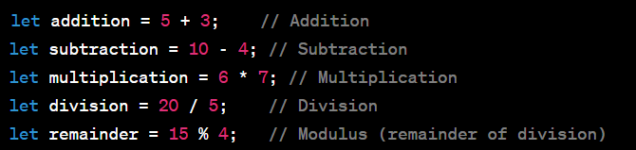
Introduction to JavaScript
Modulus (%): Returns the remainder of the division of the left operand by the right operand.
Exponentiation (**): Raises the left operand to the power of the right operand.
Increment (++): Increases the value of a variable by 1.
Decrement (--): Decreases the value of a variable by 1.

Slide 39
Introduction to JavaScript
Operator Precedence:
Operator precedence determines the order in which operators are evaluated in an expression. Operators with higher precedence are evaluated first. If operators have the same precedence, their evaluation follows left-to-right associativity.
Here's a general overview of the precedence of arithmetic operators (from highest to lowest):
Exponentiation (**)
Multiplication (*), Division (/), Modulus (%)
Addition (+), Subtraction (-)
Increment (++), Decrement (--)

Slide 40
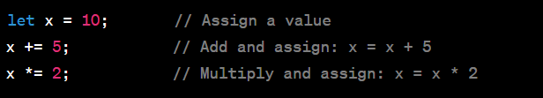
Introduction to JavaScript
2. Assignment Operators:
These operators assign values to variables.

Slide 41
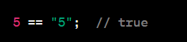
Introduction to JavaScript
3. Comparison operators for evaluating conditions
Comparison operators in JavaScript are used to evaluate conditions and make logical comparisons between values. They return boolean values (true or false) indicating whether a particular condition is satisfied. Here are the common comparison operators:
Equal to (==): Checks if two values are equal, regardless of their data types. It performs type coercion if necessary.

Slide 42
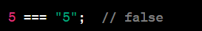

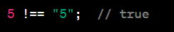
Introduction to JavaScript
2. Strict Equal to (===): Checks if two values are equal and of the same data type.
3. Not Equal to (!=): Checks if two values are not equal, regardless of their data types.
4. Strict Not Equal to (!==): Checks if two values are not equal or have different data types.

Slide 43
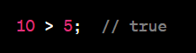
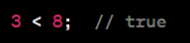
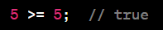
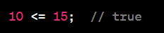
Introduction to JavaScript
5. Greater than (>): Checks if the left operand is greater than the right operand.
6. Less than (<): Checks if the left operand is less than the right operand.
7. Greater than or Equal to (>=): Checks if the left operand is greater than or equal to the right operand.
8. Less than or Equal to (<=): Checks if the left operand is less than or equal to the right operand.

Slide 44
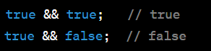
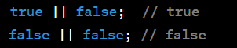
Introduction to JavaScript
4. Logical operators for boolean logic
Logical operators in JavaScript are used to perform boolean logic operations on boolean values (true or false) or expressions that can be evaluated as such. Here are the common logical operators:
Logical AND (&&): Returns true if both operands are true, otherwise returns false.
Logical OR (||): Returns true if at least one operand is true, otherwise returns false.

Slide 45
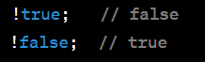
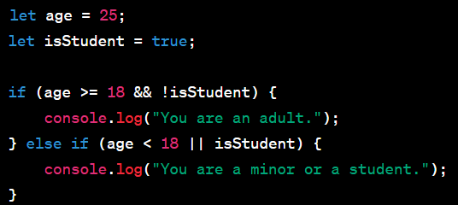
Introduction to JavaScript
3. Logical NOT (!): Reverses the boolean value of an operand.
Logical operators are often used in conditional statements (if, else if, else) and loops to control the flow of code based on conditions:
In this example, the && and || operators are used to create compound conditions, and the ! operator is used to negate the isStudent value.

Slide 46
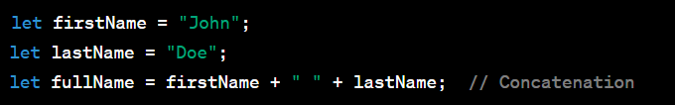
Introduction to JavaScript
5. String Concatenation:
The + operator is used to concatenate strings.

Slide 47
Introduction to JavaScript
Expressions:
Expressions are combinations of values, variables, and operators that produce a result. An expression can be as simple as a single value or complex involving multiple operators.

Slide 48
Introduction to JavaScript(Exercise 2)
Exercise 2: Temperature Converter
Imagine you are creating a temperature converter program that can convert temperatures between Celsius and Fahrenheit. Use operators and expressions to implement this functionality.
Create Variables: Declare two variables to store the following:
A temperature value in Celsius
A temperature value in Fahrenheit
Convert Celsius to Fahrenheit:

Slide 49
Introduction to JavaScript(Exercise)
Use the formula (Celsius × 9/5) + 32 to convert the Celsius temperature to Fahrenheit. Assign the result to the Fahrenheit variable.
Convert Fahrenheit to Celsius: Use the formula (Fahrenheit - 32) × 5/9 to convert the Fahrenheit temperature to Celsius. Assign the result to the Celsius variable.
Print Conversion Results: Print out messages that display the original Celsius and Fahrenheit temperatures, as well as the converted values in the other unit.

Slide 50
Introduction to JavaScript(Exercise)
Exercise 3: Age Group Classifier
Create a program that classifies a person into different age groups based on their age. Use comparison operators to determine which group the person falls into.
Declare Variables: Declare a variable to store the person's age.
Determine Age Group: Use comparison operators to determine which age group the person belongs to:
If age is less than 13, classify as "Child".
If age is between 13 and 19 (inclusive), classify as "Teenager".
If age is between 20 and 59 (inclusive), classify as "Adult".
If age is 60 or older, classify as "Senior".
Print Classification: Print out a message that includes the person's age and the determined age group.

Slide 51
Introduction to JavaScript(Exercise)
Exercise 4: Bill Splitter
Imagine you and your friends went to a restaurant and want to split the bill evenly. Create a program that calculates the amount each person needs to pay, including tip and tax.
Declare Variables: Declare variables to store the following:
Total bill amount
Number of people
Tip percentage
Tax percentage

Slide 52
Introduction to JavaScript(Exercise)
Calculate Total Payment: Calculate the total payment including tip and tax:
Calculate tip amount: (totalBill * tipPercentage) / 100
Calculate tax amount: (totalBill * taxPercentage) / 100
Calculate total payment: totalBill + tipAmount + taxAmount
Calculate Individual Payment: Calculate the amount each person needs to pay by dividing the total payment by the number of people.
Print Results: Print out messages that display the original bill amount, tip and tax amounts, total payment, and individual payments.

Slide 53
Introduction to JavaScript(Exercise)
Exercise 5: Admission Eligibility Checker
Create a program that checks if a student is eligible for admission based on certain criteria.
Declare Variables: Declare variables to store the following information:
Student's age
High school diploma status (true/false)
Entrance exam score
Check Eligibility: Determine if the student is eligible for admission using logical operators:
The student must be at least 18 years old.
The student must have a high school diploma.
The student's entrance exam score must be at least 80.
Print Eligibility Status: Print a message indicating whether the student is eligible for admission or not.

Slide 54
Control Flow
Control flow in programming refers to the order in which statements or instructions are executed in a program. It allows you to control the flow of execution based on conditions, loops, and branching.
Conditional Statements: Conditional statements allow you to execute code blocks based on specific conditions. In JavaScript, you have the if, else if, and else statements for conditional execution.

Slide 55
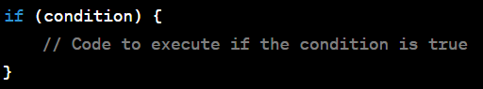
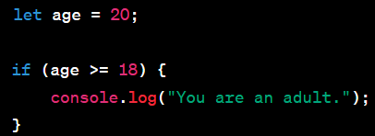
Control Flow
if Statement:
The if statement allows you to execute a block of code if a specified condition is true. If the condition is false, the code inside the if block is skipped.
Example:

Slide 56
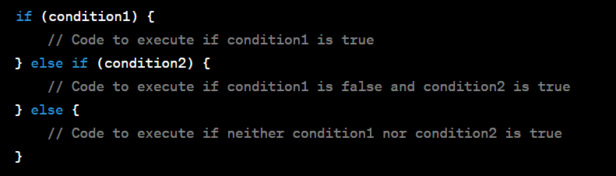
Control Flow
else if Statement:
The else if statement allows you to provide an additional condition to test if the initial if condition is false. You can have multiple else if blocks after an if block.

Slide 57
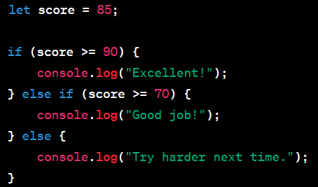
Control Flow
else if Example:
In this example, "Good job!" will be printed to the console because the score variable meets the second condition.

Slide 58
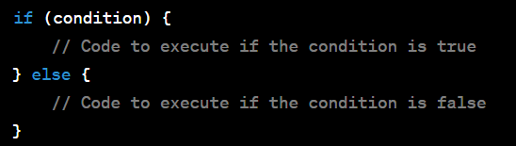
Control Flow
else Statement:
The else statement is used to provide a default block of code to execute when none of the preceding conditions are true.

Slide 59
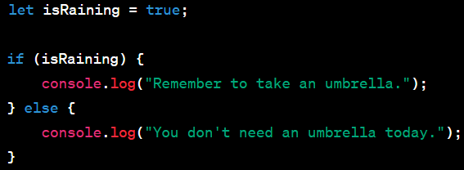
Control Flow
else Example:
In this example, "Remember to take an umbrella." will be printed to the console because isRaining is true

Slide 60
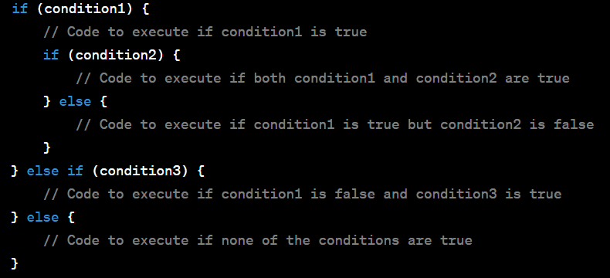
Control Flow
Nesting if statements means placing one if statement inside another. This allows you to create more complex decision-making logic by evaluating multiple conditions. Each nested if statement is executed based on the condition of the outer if or preceding else if block.

Slide 61
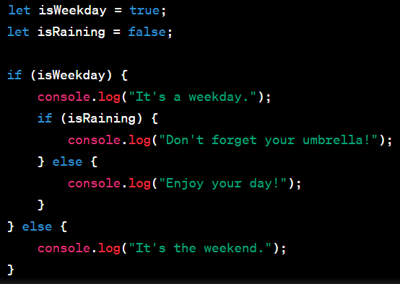
Control Flow
Nesting if statements Example:
In this example, the nested if statement checks whether it's raining only if it's a weekday. If it's a weekday and it's raining, it advises to bring an umbrella; otherwise, it suggests enjoying the day.

Slide 62
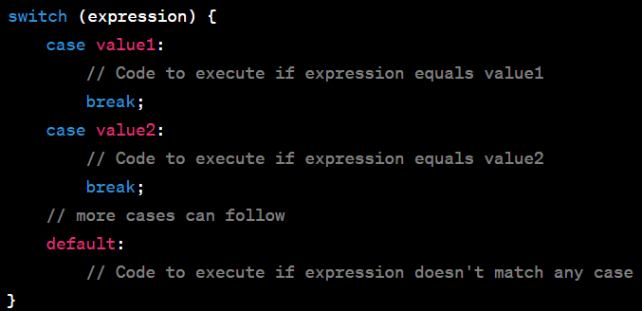
Control Flow
2. Switch Statement: The switch statement allows you to select one of many code blocks to be executed. It's particularly useful when you have multiple cases to consider.Here's how a switch statement works:

Slide 63
Control Flow
The switch statement evaluates the expression and compares it to the values listed in the case clauses.
If the expression matches a case value, the corresponding code block is executed.
The break statement is used to exit the switch statement once a matching case is found. If you omit the break, execution will continue into the next case(s).
If none of the cases match the expression, the code block under default (if provided) is executed.

Slide 64
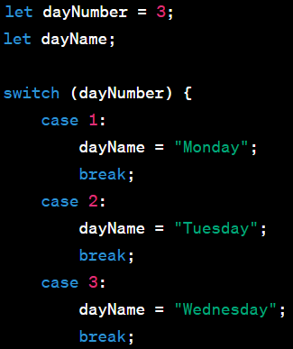
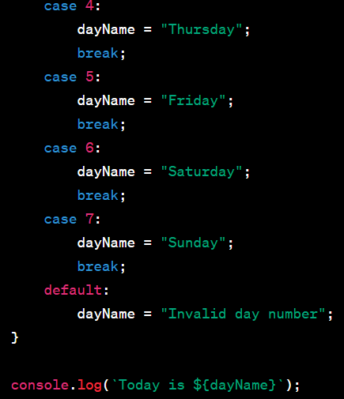
Control Flow
Switch Example:
In this example, the switch statement evaluates dayNumber, which is set to 3. The code block under case 3 is executed, and "Today is Wednesday" is printed to the console.

Slide 65
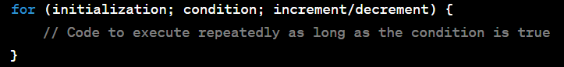
Control Flow
3. Loops:
Loops allow you to repeatedly execute a block of code. JavaScript provides several loop structures, including for, while, and do...while loops.
for Loop:
The for loop is typically used when you know in advance how many times you want to execute a block of code. It consists of three parts:

Slide 66
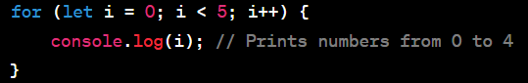
Control Flow
Initialization: It's executed before the loop starts and is usually used to initialize a loop control variable.
Condition: The loop continues executing as long as this condition is true.
Increment/Decrement: It's executed after each iteration, usually to update the loop control variable.
Example:

Slide 67
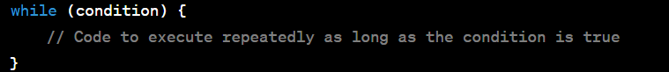
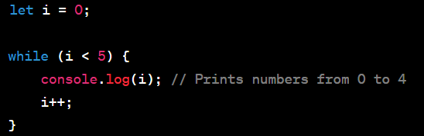
Control Flow
while Loop:
The while loop is used when you want to repeatedly execute a block of code as long as a certain condition is true. It consists of a single condition:
Example:

Slide 68
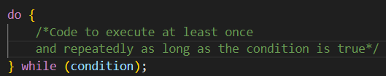
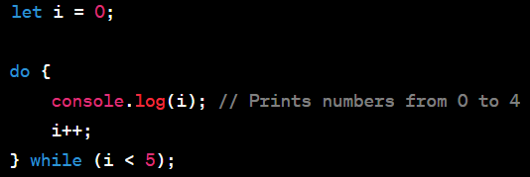
Control Flow
do-while Loop:
The do-while loop is similar to the while loop, but it guarantees that the block of code will execute at least once before checking the condition. It consists of a condition and the do keyword:
Example:

Slide 69
Control Flow
Note:
switch statements are especially useful when you have a limited set of possible values to compare against, making your code more organized and efficient compared to using a series of if/else if statements.
Choose the appropriate loop based on your specific needs. for loops are often used for iterating over a known range, while loops for situations where the number of iterations is not known in advance, and do-while loops when you want to ensure that the code block runs at least once.

Slide 70
Control Flow(Exercise)
Exercise: Grading System
Create a program that calculates and assigns grades to students based on their test scores. Use conditional statements (if, else if, else) to determine the grade for each student.
Declare Variables: Declare a variable to store the student's test score.

Slide 71
Control Flow(Exercise)
Determine the Grade: Use conditional statements to determine the grade based on the following grading scale:
A: 90 - 100
B: 80 - 89
C: 70 - 79
D: 60 - 69
F: Below 60
Print the Grade: Print out a message that includes the student's test score and the assigned grade.

Slide 72
Control Flow(Exercise)
Exercise: Day of the Week
Create a program that determines the day of the week based on a numeric input (1 for Monday, 2 for Tuesday, and so on). Use a switch statement to handle the different cases.
Declare a Variable: Declare a variable to store the numeric day input.
Use a switch Statement: Use a switch statement to determine the day of the week based on the numeric input. Each case should represent a different day of the week.
Print the Result: Print out a message that displays the day of the week corresponding to the numeric input. If the input is not in the range 1-7, print an error message.

Slide 73
Control Flow(Exercise)
Exercise: Number Sequence
Create a program that generates and prints a number sequence using different types of loops (for, while, do-while). The sequence should be the first 10 positive even numbers starting from 2.
Use a for Loop: Create a for loop to generate and print the number sequence.
Use a while Loop: Create a while loop to generate and print the same number sequence.
Use a do-while Loop: Create a do-while loop to generate and print the same number sequence.
Print the Result: Print the generated number sequence for each type of loop.

Slide 74
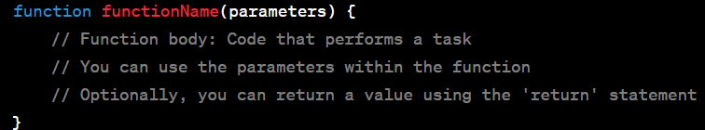
Functions
function is a block of reusable code that performs a specific task or set of tasks. Functions are fundamental building blocks of JavaScript applications and are used to encapsulate logic, promote code reusability, and make code more organized.
basic syntax for declaring and defining a function in JavaScript:

Slide 75
Functions
Function Name: This is an identifier that represents the name of the function. It should follow the rules for variable names in JavaScript. Function names are case-sensitive.
Parameters (Optional): These are placeholders for values that the function can accept as input. Parameters are enclosed in parentheses and separated by commas. Functions can have zero or more parameters.
Function Body: This is the block of code enclosed in curly braces {}. It contains the actual instructions or statements that perform a specific task when the function is invoked.
Return Statement (Optional): Functions can return a value using the return statement. The return statement exits the function and passes a value back to the caller. If a function doesn't have a return statement, it implicitly returns undefined.

Slide 76


Functions
Example of a simple function:
To use or invoke the function, you call it by its name and pass any required arguments (if any) inside the parentheses:
In this example, the greet function accepts a name parameter and returns a greeting message using that parameter.

Slide 77


Functions
Function Declaration:
To declare a function, you use the function keyword, followed by the function name, a list of parameters enclosed in parentheses, and the function body enclosed in curly braces {}.
For example:

Slide 78
Functions
Function Invocation:
To use a function, you invoke or call it by using its name followed by parentheses. If the function expects parameters, you pass the values inside the parentheses.
For example:

Slide 79

Functions
Returning Values:
Functions can also return values using the return statement. You can capture the returned value in a variable when you invoke the function.

Slide 80

Functions
Anonymous Functions: You can create functions without giving them a name, known as anonymous functions. They are often used as callbacks or assigned to variables.
Arrow Functions (ES6): Arrow functions provide a concise syntax for creating functions. They are especially useful for short, simple functions.

Slide 81

Functions
Function Declarations vs. Function Expressions:
Function declarations are hoisted, meaning they can be used before they are declared in the code. Function expressions (anonymous functions assigned to variables) are not hoisted.

Slide 82

Functions
Passing Arguments to Functions:
When you declare a function, you can specify one or more parameters in its parameter list. These parameters act as placeholders for values that you can pass into the function when you invoke it.
When you call the function, you provide values, called arguments, that match the parameters in the same order.

Slide 83

Functions
Example:

Slide 84


Functions
Returning Values from Functions:
Functions can return values using the return statement. The return statement specifies the result that the function should produce
Example:

Slide 85

Functions
Multiple Parameters and Arguments:
Functions can have multiple parameters, allowing you to pass multiple values into the function.
Ensure that the number and order of arguments match the number and order of parameters when calling the function.

Slide 86

Functions
Default Parameters (ES6):
ES6 introduced default parameter values, allowing you to specify default values for parameters if arguments are not provided when invoking the function.

Slide 87
Functions
Scope and variable visibility are fundamental concepts in JavaScript that determine where and how variables can be accessed within a program. JavaScript has two main types of scope: global scope and local scope.
Global Scope:
Variables declared outside of any function, block, or object are considered to be in the global scope.
Global variables can be accessed and modified from anywhere in your JavaScript code, including inside functions and blocks.
However, it's generally considered a best practice to limit the use of global variables to avoid unintended side effects and naming conflicts.

Slide 88

Functions
Example of a global variable:
Local Scope:
Variables declared inside a function or a block are considered to be in a local scope.
Local variables are only accessible within the function or block where they are declared.
They are not visible or accessible from outside the function or block.

Slide 89

Functions
Example of a local variable:

Slide 90

Functions
Block Scope (ES6):
ES6 introduced block scope, which allows variables to have scope limited to a block of code defined by curly braces {} (e.g., in if statements or loops).
Variables declared with let or const in block scope are not accessible outside of that block.
Example of block scope with let:

Slide 91

Functions
Variable Hoisting:
JavaScript hoists variable declarations, meaning that variables are moved to the top of their containing scope during compilation.
However, only the declarations are hoisted, not the initializations. Variables are initialized at the point in the code where they are defined.
Example of variable hoisting:
In this example, myVar is hoisted to the top of the scope, but its initialization (= 5) occurs where it's defined.

Slide 92
Functions
lexical scoping
The scope of a variable is determined by where it is declared in the source code, not where it is called or invoked. This concept ensures predictable and understandable variable visibility and scope resolution.
Here's how lexical scoping and variable visibility work in JavaScript:
Local Scope: Variables declared inside a function or block are in the local scope of that function or block. These variables are only accessible within that function or block and are not visible to the outer scopes.

Slide 93

Functions
Example local scope:

Slide 94

Functions
2. Nested Scopes: Inner functions have access to variables in their outer (enclosing) functions. This is known as lexical scope chaining. Variables in the outer scope are accessible to inner functions, but the reverse is not true.

Slide 95

Functions
3. Global Scope: Variables declared outside of any function or block are in the global scope and can be accessed from any part of the code. However, it's best practice to limit the use of global variables to avoid naming conflicts and unintended side effects.

Slide 96

Functions
4. Shadowing: If a variable with the same name is declared in an inner scope, it shadows or takes precedence over a variable with the same name in an outer scope.

Slide 97
Functions
Closures are a fundamental and powerful concept in JavaScript. They occur when a function "closes over" its lexical scope, allowing the function to access variables from its outer (enclosing) scope even after that outer function has finished executing. Closures are a crucial feature for maintaining data encapsulation and enabling more advanced programming patterns. Let's explore closures with practical examples.

Slide 98

Functions
Basic Closure Example:
In this example, inner is a closure because it has access to outerVar, which is defined in the outer scope of outer even after outer has completed execution.

Slide 99
Functions
Coding Best Practices
Use Meaningful Variable and Function Names:
Choose descriptive and self-explanatory names for variables and functions.
Avoid single-letter variable names or cryptic abbreviations.
Indentation and Consistent Formatting:
Use consistent indentation (e.g., two spaces or four spaces) to improve code readability.
Be consistent in your code formatting style.
Commenting and Documentation:
Add comments to explain complex logic, algorithms, or non-obvious code.
Use JSDoc-style comments to document functions and their parameters.

Slide 100
Functions
Avoid Global Variables:
Minimize the use of global variables to prevent naming conflicts and unintended side effects.
Use modules or closures to encapsulate and manage data.
Use Constants for Magic Numbers:
Replace magic numbers (hardcoded numerical values) with named constants.
Constants provide context and make code more maintainable.

Slide 101
Functions(Exercise)
Exercise: Calculator Functions
Create a simple calculator program with four basic arithmetic operations: addition, subtraction, multiplication, and division. You will declare and invoke functions for each operation.
Declare Functions: Declare four separate functions, one for each arithmetic operation: add, subtract, multiply, and divide. Each function should take two parameters (two numbers) and return the result of the operation.

Slide 102
Functions(Exercise)
Invoke Functions: Call each function with different sets of numbers to perform the corresponding arithmetic operations.
Print the Results: Print the results of each operation, indicating which operation was performed.

Slide 103
Functions(Exercise)
Exercise: Calculate Area and Perimeter
Create a program that calculates the area and perimeter of different geometric shapes: a rectangle and a circle. You will declare and invoke functions for each calculation.
Declare Functions:
Declare two functions: calculateRectangleArea and calculateRectanglePerimeter. These functions should take two parameters (length and width) and return the area and perimeter of a rectangle, respectively.
Declare two functions: calculateCircleArea and calculateCircleCircumference. These functions should take one parameter (the radius) and return the area and circumference (perimeter) of a circle, respectively.

Slide 104
Functions(Exercise)
Invoke Functions:
Call the rectangle functions with different sets of length and width values.
Call the circle functions with different radius values.
Print the Results:
Print the calculated area and perimeter (circumference) for each shape, indicating which calculation was performed.

Slide 105
Functions(Exercise)
Exercise: Calculate Discounts
Create a program that calculates the discounted price of a product based on different discount percentages. You will use both named function expressions and anonymous functions.
Named Function Expression:
Declare a named function expression calculateDiscountPrice that takes two parameters: the original price and the discount percentage.
Inside the function, calculate the discounted price by subtracting the discount amount from the original price.
Return the discounted price.

Slide 106
Functions(Exercise)
Anonymous Function:
Declare an anonymous function that calculates the discounted price. This function should take three parameters: the original price, the discount percentage, and a callback function.
Inside the anonymous function, calculate the discounted price using the provided discount percentage.
Invoke the callback function and pass the discounted price as an argument to it.
Invoke Functions:
Call both functions with different sets of original prices and discount percentages.
For the anonymous function, provide a callback function that prints the discounted price.

Slide 107
Functions(Exercise)
Exercise: Banking Transactions
Create a simple banking program that tracks account balances and performs transactions. This exercise will help you understand how variables in different scopes interact.
Global Scope:
Declare a global variable accountBalance with an initial value (e.g., 1000).
Function 1: Deposit Money
Declare a function deposit that takes one parameter (the deposit amount).
Inside the function, add the deposit amount to the accountBalance.
Print a message indicating the deposit amount and the new balance.

Slide 108
Functions(Exercise)
Function 2: Withdraw Money
Declare a function withdraw that takes one parameter (the withdrawal amount).
Inside the function, subtract the withdrawal amount from the accountBalance.
Print a message indicating the withdrawal amount and the new balance.
Function 3: View Balance
Declare a function viewBalance that does not take any parameters.
Inside the function, print the current account balance.
Invoke Functions:
Call each of the functions (deposit, withdraw, viewBalance) with different values to simulate banking transactions.

Slide 109

Functions(Exercise)
What is the out of the code in the right side?

Slide 110

Data Structures: Array
Arrays are one of the most commonly used data structures in JavaScript. They are used to store and manipulate collections of data. An array is a linear, ordered data structure that can hold elements of various types, including numbers, strings, objects, and even other arrays.
Creating Arrays:
You can create an array in JavaScript using either the [] literal notation or the Array constructor:

Slide 111

Data Structures: Array
Accessing Elements:
You can access elements in an array using square brackets and zero-based indexing:
Modifying Elements:
You can modify array elements by assigning new values to specific indices:
Array Length:
The length property returns the number of elements in an array:

Slide 112
Data Structures: Array
Common Array Methods:
JavaScript provides numerous built-in methods for working with arrays. Some common methods include:
push: Adds elements to the end of an array.
pop: Removes the last element from an array.
shift: Removes the first element from an array.
unshift: Adds elements to the beginning of an array.
splice: Adds or removes elements from any position in an array.

Slide 113


Data Structures: Array
Multidimensional Arrays:
Arrays can contain other arrays, creating multidimensional arrays:

Slide 114


Data Structures: Array
Splice:
splice: Adds or removes elements at a specific position in an array.
Concat:
concat: Combines two or more arrays to create a new array.

Slide 115
Data Structures: Array
Join:
join: Converts an array into a string by joining its elements with a specified separator.
Slice:
slice: Creates a new array by extracting a section of the original array.

Slide 116

Data Structures: Array
Iterating Through Arrays:
You can iterate through arrays using various techniques:
For Loop:
You can use a for loop to iterate through an array and access each element by its index.

Slide 117

Data Structures: Array
2. forEach Method:
The forEach method allows you to iterate through an array and execute a function for each element.

Slide 118

Data Structures: Array
3. Map Method:
The map method applies a function to each element of an array and returns a new array with the results.

Slide 119

Data Structures: Array
4. Filter Method:
The filter method creates a new array containing elements that pass a specific condition.

Slide 120

Data Structures: Array
5. For...of Loop (ES6):
The for...of loop simplifies array iteration by directly accessing each element.

Slide 121

Data Structures: Array
6. Using forEach with Index:
You can also use the forEach method to access both the element and its index.

Slide 122

Data Structures: Array
Array Destructuring:
Array destructuring is a powerful feature in JavaScript that allows you to easily extract values from arrays and assign them to variables.
In this example, firstFruit is assigned the value 'apple' from the first element of the fruits array, and secondFruit is assigned the value 'banana' from the second element.

Slide 123


Data Structures: Array
Skipping Elements:You can skip elements by leaving empty slots in the destructuring pattern:
Rest Parameter:The rest parameter (...) can be used to capture the remaining elements of an array into a new array:
Here, we skip the first two elements and assign 'cherry' to thirdFruit.
In this case, firstFruit captures 'apple', and restOfFruits captures the remaining elements as an array.

Slide 124

Data Structures: Array
Default Values: You can provide default values for variables in case the array doesn't have enough elements:
In this example, if the fruits array doesn't have a third element, thirdFruit is assigned the default value 'strawberry'.

Slide 125

Data Structures: Array
Swapping Values:
Array destructuring makes it easy to swap the values of two variables:
Here, the values of a and b are swapped in a single line of code.

Slide 126

Data Structures: Array
Nested Destructuring: You can also destructure nested arrays:

Slide 127

Data Structures: Array
Searching Array Methods:
1. indexOf()
The indexOf() method returns the index of the first occurrence of a specified element in an array, or -1 if the element is not found.

Slide 128

Data Structures: Array
2. lastIndexOf()
The lastIndexOf() method is similar to indexOf(), but it returns the index of the last occurrence of the specified element.

Slide 129

Data Structures: Array
3. includes()
The includes() method checks if an array contains a specified element and returns true or false.

Slide 130

Data Structures: Array
Sorting Array Methods:
4. sort()
The sort() method sorts the elements of an array in place and returns the sorted array.

Slide 131

Data Structures: Array
Keep in mind that sort() sorts elements as strings by default. You may need to provide a comparison function for more complex sorting.

Slide 132

Data Structures: Array
5. reverse()
The reverse() method reverses the order of elements in an array in place.

Slide 133

Data Structures: Array
6. Custom Sorting with sort()
You can provide a custom comparison function to the sort() method for more complex sorting logic.

Slide 134

Data Structures: Array
Spread Operator:
The spread operator is used to "spread" the elements of an array into a new array or as individual arguments in a function call.
1. Creating a Shallow Copy of an Array:

Slide 135

Data Structures: Array
2. Combining Arrays:
You can use the spread operator to concatenate or combine arrays.

Slide 136

Data Structures: Array
3. Passing Array Elements as Function Arguments:
You can pass the elements of an array as separate arguments to a function using the spread operator.

Slide 137

Data Structures: Array
Rest Operator:
The rest operator is used to collect multiple elements into a single array. It is often used in function parameter lists.
1. Collecting Function Arguments:
You can use the rest operator to collect a variable number of arguments into an array.

Slide 138

Data Structures: Array
2. Collecting Remaining Array Elements:
In destructuring, the rest operator can collect the remaining elements into an array.

Slide 139

Data Structures: Array
3. Combining with Destructuring:
You can combine the rest operator with destructuring to extract specific elements and collect the rest.

Slide 140
Data Structures: Array(Exercise)
Exercise: Arrays - Creation, Manipulation, and Iteration
Create an Array: Create an array called fruits with the following fruits: 'apple', 'banana', 'cherry'.
Accessing Elements: Access and log the second element of the fruits array.
Modifying Elements: Change the third element of the fruits array to 'grape'.
Array Length: Log the length of the fruits array.
Adding and Removing Elements: Add 'kiwi' to the end of the fruits array, and then remove it using an appropriate method.
Iterating with For Loop: Create a for loop to iterate through the fruits array and log each fruit.
Iterating with forEach: Use the forEach method to iterate through the fruits array and log each fruit.

Slide 141
Data Structures: Array(Exercise)
Exercise: Array Destructuring
Destructure an Array: Given an array colors, destructure it to extract the first and second colors into variables color1 and color2.
Skipping Elements: Given an array numbers, destructure it to skip the first two numbers and extract the third number into a variable thirdNumber.
Rest Parameter: Given an array fruits, destructure it to extract the first fruit into a variable firstFruit and collect the remaining fruits into an array called otherFruits.
Default Values: Given an array shapes, destructure it to extract the first shape into a variable firstShape and provide a default value of 'circle' in case the array is empty.
Swapping Values: Given two variables a and b, use array destructuring to swap their values without using a temporary variable.

Slide 142
Data Structures: Array(Exercise)
Exercise: Array Spread and Rest Operators
Spread Operator for Array Creation: Given two arrays fruits1 and fruits2, create a new array allFruits using the spread operator to combine both arrays.
Spread Operator for Function Arguments: Create a function called addNumbers that takes three arguments and returns their sum. Use the spread operator to pass an array of numbers to the function and calculate the sum.
Rest Operator in Function Parameters: Create a function called multiply that takes the first number as a regular parameter and the rest of the numbers as an array using the rest operator. Multiply the first number by all the other numbers in the array and return the result.
Spreading Values from an Array: Given an array colors, use the spread operator to create a new array called copiedColors that contains the same elements as colors.

Slide 143
Data Structures: Array(Exercise)
Exercise: Iterating Through Arrays
Using a for Loop: Given an array of numbers called numbers, write a for loop to iterate through the array and print each number to the console.
Using forEach Method: Given an array of colors called colors, use the forEach method to iterate through the array and print each color to the console.
Using map Method: Given an array of numbers called grades, use the map method to create a new array called squaredGrades that contains the squares of each number.
Using filter Method: Given an array of ages called ages, use the filter method to create a new array called adults that contains only ages greater than or equal to 18.

Slide 144

Data Structures: Objects
Objects in JavaScript are a fundamental data structure used to represent and store data. They consist of key-value pairs, where keys are strings (or Symbols), and values can be of any data type, including other objects.
1. Object Literals:
In JavaScript, you can create objects using object literals, which are enclosed in curly braces {}.
In this example, person is an object with three properties: firstName, lastName, and age.

Slide 145

Data Structures: Objects
2. Properties:
Properties in objects are variables that store data. They consist of a key (property name) and a value.
You can access object properties using dot notation (object.property) or bracket notation (object['property']).

Slide 146

Data Structures: Objects
3. Methods:
Methods in objects are functions stored as object properties. They allow objects to perform actions or calculations.
In this example, fullName is a method of the person object, and it returns the full name by combining the firstName and lastName properties.

Slide 147

Data Structures: Objects
4. Adding and Modifying Properties:
You can add or modify properties in an object after it's created.

Slide 148
Data Structures: Objects
5. Object Methods:
JavaScript provides built-in methods for working with objects:
Object.keys(obj): Returns an array of an object's own property keys.
Object.values(obj): Returns an array of an object's own property values.
Object.entries(obj): Returns an array of an object's own property key-value pairs as arrays.
hasOwnProperty(prop): Checks if an object has a specific property.

Slide 149

Data Structures: Objects
Example:

Slide 150

Data Structures: Objects
6. Object Nesting:
Objects can be nested within other objects to represent complex data structures.
In this example, the name property is an object itself.

Slide 151

Data Structures: Objects
7. Object Prototypes and Classes:
JavaScript supports object prototypes and class-based inheritance for creating and defining object types.
This example uses a class to define a Person object with properties and methods.

Slide 152
Data Structures: Objects (Exercise)
Exercise 1: Accessing Nested Object Properties
Create an object called student with properties: name, age, and address. The address property should be an object with street, city, and zipCode properties. Set appropriate values and then log the student's city.
Exercise 2: Adding Multiple Methods
Add two methods to the student object: greet and changeAddress. The greet method should log a greeting message using the student's name. The changeAddress method should allow you to change the student's address by providing new values for street, city, and zipCode.

Slide 153
Data Structures: Objects (Exercise)
Exercise 3: Objects - Properties, Methods, and Object Literals
Create an Object: Create an object called car representing a car with properties like make, model, and year. Set appropriate values.
Access Object Properties: Access and log the make and year properties of the car object.
Add a Method: Add a method to the car object called start that logs a message like "The car is starting" when called.
Call the Method: Call the start method on the car object to start the car.
Object Literal: Create an object literal for a book with properties like title, author, and pages. Set appropriate values.

Slide 154
Data Structures: JSON
Working with JSON (JavaScript Object Notation) data is a common task in web development and data interchange. JSON is a lightweight, human-readable data format that is easy for both humans and machines to understand. It is widely used for data storage, configuration files, and API responses.
1. JSON Syntax:
JSON data consists of key-value pairs, similar to JavaScript objects. Keys must be strings, and values can be strings, numbers, objects, arrays, booleans, or null. JSON uses double quotes for keys and string values.

Slide 155

Data Structures: JSON
Example JSON data:

Slide 156

Data Structures: JSON
2. Converting JSON to JavaScript Objects:
You can parse JSON data into JavaScript objects using the JSON.parse() method.

Slide 157

Data Structures: JSON
3. Converting JavaScript Objects to JSON:
You can convert JavaScript objects into JSON strings using the JSON.stringify() method.

Slide 158

Data Structures: JSON
4. Working with JSON Arrays:
JSON can also represent arrays of data.
You can parse and stringify JSON arrays just like objects.

Slide 159

Data Structures: JSON
5. Handling Nested JSON Data:
JSON can have nested structures, where objects or arrays are nested within other objects or arrays.

Slide 160


Data Structures: JSON
You can access nested data by chaining property or array index access.
6. Error Handling:
When parsing JSON, it's essential to handle errors, especially when dealing with data from external sources. Use try-catch blocks to handle JSON parsing errors.

Slide 161
Data Structures: JSON
7. Use Cases:
JSON is commonly used for exchanging data between a web server and a web client (e.g., AJAX requests), storing configuration settings, and storing structured data. It is also used for data serialization in many programming languages.
When working with JSON data, it's essential to understand how to parse it into JavaScript objects, manipulate the data as needed, and stringify it back to JSON when sending it to a server or storing it.
Remember that JSON data should adhere to the strict JSON syntax rules for successful parsing and stringification.

Slide 162
Data Structures: JSON(Exercise)
Exercise: Working with JSON Data
Consider a scenario where you receive JSON data from an API representing a list of books. Each book has properties like title, author, publishedYear, and price. Your task is to parse and manipulate this JSON data.
Tasks:
Parse the JSON data into an array of book objects.
Calculate and log the total price of all the books.
Filter the books published before the year 1960 and create a new array with these books.
Sort the books by their published year in ascending order.

Slide 163
Data Structures: Iterator and Generators
Iterators:
An iterator is an object that provides a consistent way to traverse a collection of data. In JavaScript, iterators are commonly used with arrays, strings, maps, sets, and other iterable data structures. Iterators are implemented using two key methods: next() and Symbol.iterator.
The next() Method: It returns an object with two properties: value (the next value in the iteration) and done (a boolean indicating whether the iteration is complete).

Slide 164

Data Structures: Iterator and Generators
Example for next() Method:
2. The Symbol.iterator Method: It is a special method that defines how an object should behave when used in a for...of loop or with the spread operator. It returns an iterator object.

Slide 165

Data Structures: Iterator and Generators
Example for Symbol.iterator Method:

Slide 166
Data Structures: Iterator and Generators
Generators:
Generators are a special type of iterator that simplifies the process of creating iterators. They are defined using a function with an asterisk (*) after the function keyword and contain one or more yield statements. Generators use the yield keyword to pause and resume execution, allowing you to control the flow of data.
Iterators: Iterators are commonly used to traverse collections like arrays, maps, and sets. They provide a standardized way to access data elements, making it easier to work with data structures in a uniform manner.
Generators: Generators are useful for building custom iterators with complex logic. They are particularly handy for handling asynchronous code using asynchronous iteration, making them suitable for tasks like fetching data from APIs and dealing with streams.

Slide 167

Data Structures: Iterator and Generators
Example of a generator function:

Slide 168
Data Structures: Iterator and Generators(Exercise)
Exercise: Iterators and Generators
You have a list of numbers, and you want to create a custom iterator using a generator function to iterate over these numbers. You also need to implement a function that calculates the sum of these numbers.
Tasks:
Create a generator function called numberGenerator that yields each number in the list.
Use the generator to calculate the sum of the numbers.

Slide 169
Working with the DOM
The Document Object Model(DOM) , is a fundamental concept in web development. It provides a structured representation of an HTML document's elements and allows you to interact with and manipulate the content and structure of web pages using programming languages like JavaScript.
What is the DOM?
Document Object Model: The DOM is a programming interface for web documents. It represents the document structure as a tree of objects, where each object corresponds to a part of the web page.
Structured Representation: It provides a structured representation of the document's elements, such as paragraphs, headings, images, forms, and more, as objects with properties and methods that can be manipulated using code.
Platform- and Language-Agnostic: The DOM is not tied to any specific programming language or platform. While it is most commonly used with JavaScript in web browsers, it can also be used with other languages and in various environments.

Slide 170
Working with the DOM
Key Concepts:
Nodes: In the DOM tree, everything is a node. There are several types of nodes:
Element Nodes: Represent HTML elements like <div>, <p>, or <a>.
Text Nodes: Contain the text content of elements.
Attribute Nodes: Represent attributes of elements.
Document Nodes: Represent the entire document.
Parent and Child Nodes: Nodes in the DOM tree have parent and child relationships. For example, an <ul> element can have <li> elements as its children.
Traversal: You can navigate through the DOM tree by moving from parent to child or from child to parent, as well as between sibling nodes.

Slide 171
Working with the DOM
Modification: You can modify the DOM by adding, removing, or changing elements and their attributes. This enables dynamic updates to web pages.
Events: The DOM allows you to attach event listeners to elements to respond to user interactions, such as clicks, mouse movements, and keyboard input.
Rendering Engine: Browsers use a rendering engine to parse HTML, create the DOM tree, and render the web page on the screen.

Slide 172
Working with the DOM
Why is the DOM Important?
Interactivity: The DOM enables the creation of interactive web pages where elements can respond to user actions, like clicking a button or submitting a form.
Dynamic Content: It allows you to change the content and structure of a web page dynamically without requiring a full page reload. This is crucial for single-page applications (SPAs) and real-time updates.
Cross-Browser Compatibility: JavaScript and the DOM provide a standardized way to work with web pages across different browsers and platforms.
Client-Side Scripting: The DOM is essential for client-side scripting, where JavaScript can manipulate the web page without relying on server-side processing.

Slide 173
Working with the DOM
Selecting Elements:
getElementById: Select an element by its unique id attribute.
getElementsByClassName: Select elements by their shared class name.
getElementsByTagName: Select elements by their tag name (e.g., 'div', 'p').

Slide 174
Working with the DOM
querySelector: Select the first element that matches a CSS selector.
querySelectorAll: Select all elements that match a CSS selector.

Slide 175
Working with the DOM
Manipulating Elements:
Once you've selected elements, you can manipulate them in various ways:
Changing Text Content: You can change the text content of an element using the textContent property.
Changing HTML Content: Use the innerHTML property to change the HTML content of an element.

Slide 176


Working with the DOM
Changing Attributes: You can change attributes of an element using methods like setAttribute
Changing Styles: Modify element styles using the style property.
Adding and Removing Classes: Use classList to add, remove, or toggle CSS classes on an element.

Slide 177


Working with the DOM
Modifying Text Content:
textContent Property: You can change the text content of an element using the textContent property. This property sets or gets the text content of an element and its descendants.
innerText Property:
Similar to textContent, the innerText property also allows you to set or get the text content of an element, but it pays attention to CSS styles and might not include hidden or styled text.

Slide 178

Working with the DOM
Modifying HTML Content:
innerHTML Property: Use the innerHTML property to change the HTML content of an element. This property can be used to insert new HTML content or replace existing content.

Slide 179
Working with the DOM
Modifying Attributes:
setAttribute Method: You can change attributes of an element using the setAttribute method. Pass the attribute name and the new value as arguments.

Slide 180

Working with the DOM
getAttribute and removeAttribute Methods:
To get the current value of an attribute, use the getAttribute method. To remove an attribute, use the removeAttribute method.

Slide 181

Working with the DOM
Modifying Styles:
style Property: To modify the CSS styles of an element, use the style property followed by the style property you want to change.

Slide 182

Working with the DOM
classList Property:
Use the classList property to add, remove, or toggle CSS classes on an element.

Slide 183

Working with the DOM
Creating Elements:
createElement() Method: You can create new HTML elements using the document.createElement() method. This method takes the tag name of the element you want to create as an argument.
Setting Properties and Attributes:
After creating an element, you can set its properties and attributes using JavaScript.

Slide 184

Working with the DOM
3. Appending Elements:
Once you've created and configured an element, you can append it to the DOM using various methods like appendChild().

Slide 185

Working with the DOM
Removing Elements:
removeChild() Method: You can remove elements from the DOM using the removeChild() method. This method is called on the parent element, and you pass the child element you want to remove as an argument.

Slide 186
Working with the DOM
2. remove() Method (Modern Browsers):
A more modern and straightforward way to remove an element is by using the remove() method directly on the element itself.
3. parentNode Property:
You can also use the parentNode property to access the parent of an element and then remove the child.

Slide 187

Working with the DOM
Cloning Elements:
You can create a copy of an existing element using the cloneNode() method. This is useful when you want to duplicate elements.

Slide 188

Working with the DOM
Replacing Elements:
You can replace one element with another using the replaceChild() method. This is useful when you want to update the content of an element.

Slide 189
Working with the DOM
Event handling and listeners
Event handling and event listeners are fundamental concepts in web development, as they allow you to create interactive and responsive web applications. Events are actions or occurrences that happen in the browser, such as a user clicking a button or pressing a key. Event listeners are JavaScript functions that wait for and respond to specific events.
Adding Event Listeners:
You can add event listeners to HTML elements to specify which JavaScript function should be executed when a particular event occurs. Common events include clicks, mouse movements, keyboard input, form submissions, and more.

Slide 190

Working with the DOM
Using addEventListener:
The addEventListener method is the most common way to attach event listeners to elements. It allows you to specify the event type and the function to execute when the event occurs.
Using Inline Event Handlers:
You can also define event handlers directly in HTML attributes. However, this approach is less common and not recommended for complex applications.

Slide 191

Working with the DOM
Event Object:
When an event occurs, an event object is automatically passed to the event handler function. This object contains information about the event, such as the target element and event type. You can access this object as a parameter in your event handler function:

Slide 192

Working with the DOM
Removing Event Listeners:
You can remove event listeners when they are no longer needed. To remove an event listener, you need to specify the same function that was used to add it. This is essential to avoid memory leaks.

Slide 193
Working with the DOM
Common Event Types:
Here are some common event types you may encounter:
click: Occurs when an element is clicked.
mousedown and mouseup: Occur when the mouse button is pressed down and released.
mouseenter and mouseleave: Occur when the mouse enters and leaves an element.
keydown and keyup: Occur when a keyboard key is pressed down and released.
submit: Occurs when a form is submitted.
change: Occurs when the value of an input element changes.

Slide 194

Working with the DOM
Event Bubbling:
Event bubbling is the default behavior in the DOM where an event triggered on an element will "bubble up" through its ancestors in the DOM tree. This means that when an event occurs on an inner element, it also triggers the same event on all of its parent elements.
For example, if you have a nested structure of HTML elements like this:

Slide 195

Working with the DOM
And you attach a click event listener to both the parent and child elements:
If you click the "Click me" button, you'll see both "Child clicked" and "Parent clicked" logged to the console. This is because the click event bubbles up from the child element to the parent element.

Slide 196

Working with the DOM
Event Delegation:
Event delegation is a technique that takes advantage of event bubbling to simplify event handling, especially in cases where you have many similar elements to which you want to attach the same event listener. Instead of attaching an event listener to each individual element, you attach a single event listener to a common ancestor and then use conditional statements to determine which specific element triggered the event.
Here's an example using event delegation:

Slide 197

Working with the DOM
In this example, a single event listener is attached to the ul element. When a li element is clicked, the event bubbles up to the ul, and the event handler checks if the clicked element has the tagName "LI." If it does, it logs the content of the clicked li element.

Slide 198

Working with the DOM (Exercise)
Exercise: Creating a To-Do List with Adding and Removing Tasks
In this exercise, you'll create a to-do list where users can add tasks and remove them.
Create an HTML file (index.html) with the given structure:

Slide 199
Working with the DOM (Exercise)
Create a JavaScript file (script.js) and link it to your HTML file. In this JavaScript file, write code to:
Select the list element with the ID "todoList."a
Select the input field with the ID "newTask."
Select the button with the ID "addTask."
Add an event listener to the "Add Task" button that creates a new list item with the text from the input field and appends it to the list.
Add an event listener to each list item to remove it when clicked.

Slide 200
Asynchronous JavaScript
Asynchronous JavaScript refers to the practice of writing JavaScript code that can handle tasks without blocking the execution of other code.
In synchronous programming, each task is executed one after the other, and the program waits for each task to complete before moving on to the next one.
In contrast, asynchronous programming allows multiple tasks to be executed concurrently, making the program more responsive and efficient.
Asynchronous JavaScript is particularly valuable when dealing with tasks that involve waiting for external resources, such as data from a server or user input, as it allows your program to remain responsive and efficient during those waiting periods.

Slide 201
Asynchronous JavaScript
key concepts related to asynchronous JavaScript:
Callbacks: A callback is a function that is passed as an argument to another function and is executed once that function completes its operation.
Promises: A More Structured Approach.provides a clean way to handle success and error cases of asynchronous operations.
Async/Await: Modern Asynchronous Syntax
Event Loop: checks the message queue for tasks that need to be executed.
Non-Blocking I/O:the program can continue executing other tasks while waiting for I/O operations to complete, improving overall efficiency.
Concurrency: Asynchronous code allows you to handle multiple tasks concurrently
Error Handling: Promises and async/await provide mechanisms for handling errors and propagating them to the appropriate error-handling code.

Slide 202
Asynchronous JavaScript
Callback functions
Callback functions are a fundamental concept in JavaScript and asynchronous programming. They are functions that are passed as arguments to other functions and are executed after the completion of a specific task or event.
Callbacks are widely used to handle asynchronous operations, respond to user interactions, and structure code in a way that promotes modularity and reusability.
Callback functions are powerful but they can also lead to callback hell (nested callbacks) in complex code. To address this, newer asynchronous patterns like Promises and async/await have been introduced in JavaScript to make asynchronous code more readable and maintainable.

Slide 203
Asynchronous JavaScript
key characteristics and uses of callback functions:
Event Handling: Handling User Interactions
Asynchronous Operations: Reading Files, Making Network Requests
Modularity: Reusing Callback Functions
Error Handling: Handling Errors in Asynchronous Code

Slide 204


Asynchronous JavaScript
Defining, Passing, and Executing Callbacks
Defining a Callback Function
Callback functions are defined like regular JavaScript functions.
Passing a Callback Function
Callbacks are passed as arguments to higher-order functions or event listeners.

Slide 205

Asynchronous JavaScript
3. Execution of Callbacks
Callbacks are executed when a specific condition is met, such as the completion of an asynchronous operation or an event trigger.

Slide 206

Asynchronous JavaScript
4. Handling Asynchronous Operations
Callbacks are commonly used to handle asynchronous operations like fetching data from a server.

Slide 207
Asynchronous JavaScript(Exercise)
Instructions:
For each task, read the description, write the code to achieve the task using callback functions, and provide comments explaining your code.
Task 1: Use Callback for Summation: Create a function called sum that takes two numbers and a callback function as arguments. The sum function should calculate the sum of the two numbers and invoke the callback function with the result.
Task 2: Callback for Validation: Create a function called validateEmail that takes an email address and a callback function. The validateEmail function should check if the email address is valid (e.g., contains "@" and "."), and then invoke the callback function with a boolean indicating whether it's valid.

Slide 208
Asynchronous JavaScript
Promises
Promises are a powerful feature in JavaScript for managing asynchronous operations. They provide a more structured and readable way to work with asynchronous code compared to traditional callback functions. Promises can be used to create, chain, and handle errors in asynchronous tasks.

Slide 209

Asynchronous JavaScript
Creating a Promise
A Promise is created using the Promise constructor, which takes a single argument: an executor function.

Slide 210

Asynchronous JavaScript
Chaining Promises
Promises can be chained together to perform a sequence of asynchronous tasks.

Slide 211

Asynchronous JavaScript
Error Handling with Promises
The .catch method can be used to handle errors in the Promise chain.

Slide 212

Asynchronous JavaScript
Example: Fetching Data with Promises
Demonstrate an example of fetching data using the fetch API with Promises.

Slide 213
Asynchronous JavaScript
Fetch API(Application Programming Interface) for making HTTP requests
The Fetch API is a modern JavaScript interface for making HTTP requests to servers or APIs. It provides a more powerful and flexible way to work with network requests compared to older techniques like XMLHttpRequest. The Fetch API is designed around Promises, making it easier to work with asynchronous operations and handle responses.

Slide 214

Asynchronous JavaScript
Basic Fetch Syntax
Fetching data with the Fetch API involves a simple and intuitive syntax.

Slide 215

Asynchronous JavaScript
Handling the Response
The fetch function returns a Promise that resolves to a Response object.
You can check the response status and handle it accordingly.

Slide 216

Asynchronous JavaScript
HTTP Methods
Fetch supports various HTTP methods, such as GET, POST, PUT, and DELETE, by specifying the method option.

Slide 217

Asynchronous JavaScript
Headers and Options
You can set headers, pass options, and handle various types of content (e.g., JSON, form data) with the Fetch API.

Slide 218

Asynchronous JavaScript
Async/await syntax
The async/await syntax is a feature introduced in JavaScript (ES2017) for handling asynchronous code in a more synchronous and readable manner. It allows you to write asynchronous code that looks similar to synchronous code, making it easier to work with promises and asynchronous operations.
Declaring an async Function
To use await, you declare a function as async. This signifies that the function contains asynchronous code.

Slide 219

Asynchronous JavaScript
Using await to Wait for Promises
Inside an async function, you can use the await keyword to pause the function's execution until a Promise is resolved.

Slide 220

Asynchronous JavaScript
Error Handling with try/catch
To handle errors in async/await code, you can use try/catch blocks, just like in synchronous code.

Slide 221

Asynchronous JavaScript
await in Loops and Concurrent Requests
You can use await in loops to make sequential requests or in parallel to make concurrent requests.

Slide 222

Asynchronous JavaScript
Working with timers (setTimeout, setInterval)
Working with timers, specifically setTimeout and setInterval, is a crucial aspect of handling asynchronous operations and scheduling tasks in JavaScript. These timers allow you to delay the execution of code or repeatedly run code at specific intervals.
setTimeout Function
setTimeout delays the execution of a function or code block by a specified time (in milliseconds).

Slide 223


Asynchronous JavaScript
Using setTimeout for Asynchronous Code
setTimeout is often used for delaying asynchronous operations, such as fetching data after a timeout.
setInterval Function
setInterval repeatedly executes a function or code block at specified intervals.

Slide 224

Asynchronous JavaScript
Clearing Timers
To stop or clear a timer, you can use the clearTimeout or clearInterval functions.

Slide 225
Asynchronous JavaScript(Exercise)
Instructions: For task 1, read the description, write the code to achieve the task using Promises, and provide comments explaining your code.
Task 1: Create a Simple Promise
Create a Promise called simplePromise that resolves with a message after a delay of 2 seconds using setTimeout.

Slide 226
Asynchronous JavaScript(Exercise)
Instructions:
For each task, read the description, write the code to achieve the task using timers, and provide comments explaining your code.
Task 1: Delayed Message: Create a function called delayedMessage that displays a message after a specified delay using setTimeout.
Task 2: Countdown Timer: Create a function called countdownTimer that displays a countdown from a specified starting number to zero using setInterval. Once the countdown reaches zero, display a "Time's up!" message.

Slide 227
Error Handling and Debugging
Introduction to Error Handling and Debugging
The Role of Error Handling
Error handling is a critical aspect of software development.
It involves identifying, managing, and resolving issues or "bugs" in your code.
Why Errors Occur
Errors can occur for various reasons:
Syntax errors: Mistakes in the code's structure that prevent execution.
Runtime errors: Issues that arise during code execution, such as division by zero.
Logical errors: Flaws in the program's logic that produce incorrect results.

Slide 228
Error Handling and Debugging
The Consequences of Ignoring Errors
Ignoring errors can lead to:
Crashes and program instability.
Data loss or corruption.
Frustrated users and poor user experiences.
The Debugging Process
Debugging is the systematic process of finding and fixing errors in your code.
It involves identifying the root cause of an issue and implementing a solution.

Slide 229
Error Handling and Debugging
Debugging Techniques
Debugging techniques include:
Logging: Using console.log statements to inspect variables and program flow.
Breakpoints: Pausing code execution at specific points to examine variables and state.
Stepping through code: Executing code line by line to pinpoint issues.
Profiling: Analyzing code performance to optimize it.
The Importance of Error Messages
Error messages are valuable diagnostic tools.
They provide information about the type and location of errors.
Proper error messages aid in faster issue resolution.

Slide 230
Error Handling and Debugging
Error Handling Strategies
Error handling strategies involve:
Using try-catch blocks to gracefully handle exceptions.
Providing informative error messages to aid debugging.
Implementing fallback mechanisms to ensure program stability.
Testing and Validation
Writing tests and validating inputs can prevent errors before they occur.
Automated testing tools and frameworks help catch errors during development.

Slide 231

Error Handling and Debugging
Understanding common JavaScript errors
1. SyntaxError
Occurs when there's a mistake in the code's structure.
Common causes include missing parentheses, semicolons, or typos.
2. ReferenceError
Occurs when trying to access an undefined variable or object.
Ensure that variables are declared before use.

Slide 232

Error Handling and Debugging
3. TypeError
Occurs when an operation is performed on an inappropriate data type.
For example, attempting to call a method on a non-function.
4. RangeError
Occurs when an invalid range of values is provided, often with methods like substring or slice.

Slide 233

Error Handling and Debugging
5. TypeError with null or undefined
Attempting to access properties or call methods on null or undefined values can result in a TypeError.
6. SyntaxError with JSON Parsing
Invalid JSON can cause a SyntaxError.

Slide 234

Error Handling and Debugging
7. Network Errors
Errors related to network requests, such as failed fetch requests or CORS issues.

Slide 235

Error Handling and Debugging (Exercise)
Objective: In this exercise, you'll be presented with common JavaScript code snippets containing errors. Your task is to identify and fix the errors.
Instructions:
For each code snippet, read the code and the error message (if provided), identify the error(s), and fix them. Then, explain the error(s) and the solution in a comment.
Code Snippet 1:

Slide 236


Error Handling and Debugging (Exercise)
Code Snippet 2:
Code Snippet 3:

Slide 237


Error Handling and Debugging (Exercise)
Code Snippet 4:
Code Snippet 5:

Slide 238

Error Handling and Debugging (Exercise)
Code Snippet 6:

Slide 239
Error Handling and Debugging
Using the Browser's Developer Tools
Opening Developer Tools
To access developer tools:
In Chrome and Edge: Press F12 or Ctrl+Shift+I (Windows/Linux) or Cmd+Option+I (Mac).
In Firefox: Press F12 or Ctrl+Shift+I (Windows/Linux) or Cmd+Option+I (Mac).
In Safari: Go to Preferences > Advanced and enable "Show Develop menu in menu bar," then use Cmd+Option+I.
Alternatively, right-click on a webpage and select "Inspect" or "Inspect Element."

Slide 240
Error Handling and Debugging
Elements Tab
Inspect and modify HTML and CSS in real time.
Edit and experiment with styles, layout, and content.
Identify and locate elements in the DOM.
Console Tab
View and interact with JavaScript console messages:
Use console.log() to log information for debugging.
Catch and handle errors and exceptions.
Evaluate JavaScript expressions and commands.

Slide 241
Error Handling and Debugging
Sources Tab (Debugger)
Set breakpoints to pause code execution at specific lines.
Step through code line by line.
Inspect variables and call stacks.
Blackbox scripts to exclude them from debugging.
Network Tab
Monitor network requests:
View request and response headers.
Inspect the content of HTTP requests and responses.
Analyze load times and performance.

Slide 242
Error Handling and Debugging
Application Tab
Inspect and manage browser storage:
View and edit cookies, local storage, and session storage.
Access IndexedDB and Web SQL databases.
Debug service workers.
Performance Tab
Profile web page performance:
Record and analyze runtime performance.
Identify bottlenecks and slow code.
Optimize for better user experiences.

Slide 243
Error Handling and Debugging
Security Tab
Check for security issues:
View certificate information.
Detect and handle mixed content (HTTP/HTTPS).
Access security reports and warnings.
Lighthouse (Audits)
Run audits to evaluate web page quality and performance:
Assess accessibility, SEO, and best practices.
Get recommendations for improvements.

Slide 244
Error Handling and Debugging
Debugging Techniques and Breakpoints
Debugging Techniques
Debugging is the process of finding and fixing errors in your code.
Effective debugging requires systematic approaches and tools.
Logging (console.log)
The simplest debugging technique is using console.log statements.
Log variable values, function outputs, or execution flow to the browser console.
Helpful for understanding how your code behaves.

Slide 245
Error Handling and Debugging
Breakpoints
Breakpoints are markers in your code where execution pauses for inspection.
Set breakpoints in the browser's developer tools.
Useful for in-depth examination of code behavior.
Types of Breakpoints
Line Breakpoints: Pause at a specific line of code.
Conditional Breakpoints: Pause only when a specified condition is met.
Function Breakpoints: Pause when a specific function is called.

Slide 246
Error Handling and Debugging
Setting Breakpoints
In the "Sources" or "Debugger" tab of developer tools:
Click on the line number to set a line breakpoint.
Right-click on a line to add a conditional breakpoint.
Stepping Through Code
Use step commands to move through code execution:
Step Over: Execute the current line and move to the next.
Step Into: Dive into a function being called.
Step Out: Finish executing the current function and return to the caller.

Slide 247

Error Handling and Debugging
Inspecting Variables
While paused at a breakpoint, inspect variable values:
Hover over variables to see their current values.
Add variables to watchlist for continuous monitoring.
Conditional Breakpoints
Set breakpoints that trigger only when specific conditions are met:
Right-click on a breakpoint and add a condition.

Slide 248
Error Handling and Debugging
Function Breakpoints
Pause code execution when a specific function is called:
Set a function breakpoint in the developer tools.

Slide 249

Error Handling and Debugging
Handling Exceptions with try...catch
The try...catch Statement
The try block contains code that might throw an exception.
The catch block handles the exception if one is thrown.
Optionally, an finally block can be used to execute code regardless of whether an exception is thrown.

Slide 250
Error Handling and Debugging
How try...catch Works
When an exception is thrown inside the try block:
Code execution in the try block stops.
Control is transferred to the catch block.
The catch block can access information about the exception through the error parameter.

Slide 251

Error Handling and Debugging
Handling Exceptions
In the catch block, you can:
Log the error.
Provide alternative code paths.
Re-throw the error to propagate it to higher levels of the program

Slide 252

Error Handling and Debugging
Multiple catch Blocks
You can have multiple catch blocks to handle different types of exceptions.
The first matching catch block is executed.

Slide 253

Error Handling and Debugging
The finally Block
The finally block, if provided, runs regardless of whether an exception is thrown.
Use it for cleanup operations like closing files or releasing resources.

Slide 254

Error Handling and Debugging (Exercise)
Objective: In this exercise, you'll work with code snippets that contain potential errors. Your task is to use try...catch blocks to handle these errors gracefully.
Instructions:
For each code snippet, read the code and identify the potential error(s). Then, wrap the code in a try...catch block to catch and handle the errors. Provide a comment explaining the error and how you handled it.
Code Snippet 1:

Slide 255

Error Handling and Debugging
Console Methods for Debugging
console.log()
The most commonly used console method.
Logs messages or data to the console.
Helpful for general debugging and inspecting variable values.

Slide 256


Error Handling and Debugging
console.error()
Logs error messages to the console.
Typically used for reporting and highlighting errors.
Messages are often displayed in red for emphasis.
console.warn()
Logs warning messages to the console.
Useful for alerting developers to potential issues or deprecated features.
Messages are often displayed in yellow.

Slide 257


Error Handling and Debugging
console.info()
Logs informational messages to the console.
Typically used for non-error information that might be helpful for debugging or tracking code execution.
console.assert()
Logs a message and a stack trace if a specified condition is false.
Useful for checking assumptions in code and ensuring specific conditions are met.

Slide 258

Error Handling and Debugging
console.debug()
Logs debug messages to the console.
Similar to console.log but provides a way to filter out debug messages in production environments.
Useful for detailed debugging in development.

Slide 259
Error Handling and Debugging(Exercise)
Objective: In this exercise, you'll work with code snippets that contain potential issues or bugs. Your task is to use console methods for debugging to identify and fix these issues.
Instructions:
For each code snippet, read the code, identify the issues, and use console methods (e.g., console.log, console.error, console.warn, console.debug, etc.) to debug the code. Provide comments explaining the issues you found and how you fixed them.

Slide 260

Error Handling and Debugging(Exercise)
Code Snippet

Slide 261
Advanced JavaScript Concepts
Closures:
A closure is a function bundled together with its lexical environment, which includes the variables and references to variables that were in scope when the closure was created.
Closures allow a function to access variables from an outer function, even after the outer function has finished executing.
They provide a way to create private variables and data encapsulation.

Slide 262

Advanced JavaScript Concepts
Example of a Closure:

Slide 263

Advanced JavaScript Concepts
Lexical Scope:
Lexical scope refers to the static scope of variables in JavaScript, determined by where the variables are declared in the code.
Variables are accessible from within the function where they are defined and any nested functions.

Slide 264

Advanced JavaScript Concepts
Hoisting
Hoisting is a JavaScript mechanism where variable and function declarations are moved to the top of their containing scope during the compilation phase.
This means that variables and functions can be used before they are declared in the code.
Variable Declaration
Variables declared using var are hoisted, but only the declarations are moved to the top.
The initializations remain in place.

Slide 265


Advanced JavaScript Concepts
Function Declaration
Function declarations are also hoisted, including both the function name and its body.
This allows you to call functions before their actual code appears in the source code.
Variable Declarations vs. Assignments
It's important to note that only variable declarations are hoisted, not their assignments.
Assignments remain in place and are executed in order.

Slide 266

Advanced JavaScript Concepts
Hoisting with let and const
Variables declared with let and const are also hoisted, but they are not initialized with undefined like var.
This is known as the "temporal dead zone."
Best Practices
To avoid unexpected behavior, it's recommended to declare variables at the top of their scope.
Use let and const for variable declarations to avoid the temporal dead zone.

Slide 267
Advanced JavaScript Concepts(Exercise)
Objective: In this exercise, you'll practice creating and using closures to capture and preserve the lexical scope of variables.
Instructions:
1. Create a Counter Function:
Create a function called counter that doesn't take any arguments.
Inside the counter function, declare a variable called count and set it to 0.
Return an object with two methods:
increment(): This method should increment the count variable by 1 and return the updated count.
getCount(): This method should return the current value of count

Slide 268
Advanced JavaScript Concepts(Exercise)
2. Create Two Counter Instances:
Create two instances of the counter function and store them in variables counter1 and counter2.
Use the increment method on both counter1 and counter2 multiple times and log the results.
3. Closure Example:
Create a function called createMultiplier that takes a multiplier argument.
Inside the createMultiplier function, declare a nested function called multiply that takes a number argument.
The multiply function should return the result of multiplying number by multiplier.
Return the multiply function from the createMultiplier function.

Slide 269
Advanced JavaScript Concepts(Exercise)
4, Create Multiplier Instances:
Create two instances of the createMultiplier function with different multipliers (e.g., 2 and 3) and store them in variables.
Use the instances to create functions that double and triple a given number.
Use these functions to double and triple different numbers and log the results.

Slide 270
Advanced JavaScript Concepts
What is 'this'?
The this keyword refers to the current execution context in JavaScript.
Its value depends on how and where a function is called.
Global Context
In the global context (outside of any function), this refers to the global object, which is window in a web browser.

Slide 271

Advanced JavaScript Concepts
Function Context
In a regular function, this refers to the global object (e.g., window) by default.

Slide 272

Advanced JavaScript Concepts
Object Method Context
When a function is called as a method of an object, this refers to the object itself.

Slide 273

Advanced JavaScript Concepts
Constructor Function Context
Inside a constructor function (used to create objects), this refers to the newly created instance of the object.

Slide 274

Advanced JavaScript Concepts
Event Handler Context
In event handlers, such as those used in the DOM, this often refers to the element that triggered the event.

Slide 275

Advanced JavaScript Concepts
Arrow Functions and 'this'
Arrow functions do not have their own this. They inherit the this value from their surrounding lexical context.

Slide 276
Advanced JavaScript Concepts(Exercise)
Exercise: The 'this' Keyword and Context
1. Create an object called 'person' with properties: name, age, and greet. The 'greet' property should be a function that logs a greeting message including the person's name.
2. Create a standalone function 'sayHello' that logs a generic greeting message.
3. Invoke the 'greet' method of the 'person' object and observe the output.
4. Use the 'call' method to invoke the 'greet' method of the 'person' object with a different name and age.
5. Invoke the 'sayHello' function and observe the output.
6. Create an object called 'car' with a 'start' method that logs "Engine started for [car name]".
7. Create another object called 'bike' with a 'start' method that logs "Engine started for [bike name]".
8. Invoke the 'start' method for both the 'car' and 'bike' objects.

Slide 277
Advanced JavaScript Concepts
Classes and Prototypes
JavaScript supports both classical inheritance using classes and prototypal inheritance using prototypes.
Introduction to Object-Oriented Programming (OOP):
Object-Oriented Programming is a programming paradigm that uses objects to organize code.
JavaScript is a multi-paradigm language that supports OOP.
Classes in JavaScript:
JavaScript introduced the class keyword in ES6, allowing developers to define classes and create objects with a more structured syntax.

Slide 278

Advanced JavaScript Concepts
Example of defining and using a class:

Slide 279

Advanced JavaScript Concepts
Prototypes in JavaScript:
JavaScript uses a prototype-based inheritance model, where objects inherit properties and methods from other objects.
Every JavaScript object has a prototype, which is an object from which it inherits properties.
Example:

Slide 280
Advanced JavaScript Concepts
Class vs. Prototype:
Classes: Provide a more structured and syntactic way to define objects and their behavior. Recommended for modern JavaScript applications.
Prototypes: Offer more flexibility and control but have a less intuitive syntax. Still widely used and can be more suitable for certain situations.
Inheritance in JavaScript:
Both classes and prototypes support inheritance.
In classes, you can use the extends keyword to create a subclass that inherits from a superclass.
In prototypes, you can link objects using the Object.create() method or by directly manipulating the prototype chain.

Slide 281
Advanced JavaScript Concepts
Choosing Between Classes and Prototypes:
Choose classes for modern JavaScript applications that require a clear and organized structure.
Use prototypes when you need more control or are working with existing code that uses this pattern.
Best Practices:
Follow consistent coding conventions for classes or prototypes within your project.
Consider using classes for new projects to leverage modern JavaScript features.
Document your code to make it easier for others to understand your object-oriented design.

Slide 282
Advanced JavaScript Concepts
Object Creation:
You can create objects in JavaScript using constructors or object literals.
Constructors are functions used to create objects with shared properties and methods. When you create an object using a constructor, it inherits from the constructor's prototype.
Object literals directly create objects with their own properties and methods.

Slide 283

Advanced JavaScript Concepts
Example of class and inheritance in JavaScript:

Slide 284

Advanced JavaScript Concepts
Example of prototypes and inheritance in JavaScript:

Slide 285
Advanced JavaScript Concepts
In this example:
We define a Person constructor function with properties name and age.
We add a greet method to the Person prototype, which can be shared among all Person instances.
person1 and person2 are created using the Person constructor and inherit the greet method from the Person prototype.

Slide 286
Advanced JavaScript Concepts(Exercise)
Objective: In this exercise, you'll work with JavaScript classes and prototypes to create a simple object-oriented program.
Instructions:
1. Create a Class:
Define a class called Person with the following properties and methods:
Properties: firstName, lastName, age
Method: getFullName(), which returns the full name in the format "First Last."
2. Instantiate Objects:
Create two instances of the Person class with different values for the properties.

Slide 287
Advanced JavaScript Concepts(Exercise)
3. Prototype Method:
Add a prototype method to the Person class called greet(). This method should return a greeting message including the person's first name.
4. Inheritance:
Create a subclass of Person called Student. The Student class should inherit from Person and have an additional property studentId.
Add a method to Student called study() that returns a study-related message.
5. Object Creation and Output:
Instantiate a Student object and display information about the student, including their full name, age, student ID, and a greeting.

Slide 288


Advanced JavaScript Concepts
let and const:
let and const are new variable declaration keywords introduced in ES6.
let allows you to declare variables with block scope, making them suitable for loop counters and other block-level variables.
const is used to declare constants, whose values cannot be reassigned after initialization.
Arrow Functions:
Arrow functions provide a more concise syntax for defining functions.
They have lexical scoping of this, which can be very useful in avoiding context-related issues.

Slide 289

Advanced JavaScript Concepts
Template Literals:
Template literals allow you to create multi-line strings and embed expressions within them using ${}.

Slide 290
Advanced JavaScript Concepts
Set
It is designed to store unique values of any data type, including primitive types and objects.
Key characteristics:
Uniqueness: Sets only store unique values. Duplicate values are automatically removed.
Iterability: Sets are iterable, meaning you can use loops like for...of to iterate over their values.
Order: Sets maintain the order of elements as they were inserted.
Methods:
add(value): Adds a value to the set if it doesn't already exist.
delete(value): Removes a value from the set.
has(value): Checks if a value exists in the set.
clear(): Removes all values from the set.
size (property): Returns the number of unique values in the set.

Slide 291

Advanced JavaScript Concepts
Here's an example illustrating the use of Set:
In this example, the Set uniqueSet stores unique values and automatically removes duplicates. You can add, delete, and check for values in the set, and you can also iterate over its contents.

Slide 292
Advanced JavaScript Concepts(Exercise)
Exercise: Write a function that takes an array of numbers and returns a new array containing only the unique numbers (no duplicates) in the same order as they appear in the original array. Use advanced JavaScript concepts like Set, map, or the spread operator (...) to solve this problem.

Slide 293
Advanced JavaScript Concepts(Exercise)
Objective: In this exercise, you'll practice using let and const for variable declaration, creating arrow functions, and working with classes in JavaScript.
Instructions:
1. Variable Declarations (let and const):
Declare a variable called age using let and set it to your age.
Declare a constant variable called PI using const and set it to the value of pi (approximately 3.14159).
2. Arrow Functions:
Create an arrow function called square that takes a number as an argument and returns its square.
Create an arrow function called sum that takes two numbers as arguments and returns their sum.

Slide 294
Advanced JavaScript Concepts(Exercise)
3. Class Creation:
Create a class called Person with a constructor that takes name and age as parameters and sets them as properties of the instance.
Add a method to the Person class called greet that returns a greeting message in the format "Hello, my name is {name} and I'm {age} years old."
4. Class Inheritance:
Create a subclass of Person called Student. The Student class should inherit from Person and have an additional property studentId.
Override the greet method in the Student class to include the student's ID in the greeting.
5. Object Creation and Output:
Create an instance of the Person class with your name and age.
Create an instance of the Student class with your name, age, and a student ID.
Call the greet method on both the Person and Student instances and log the results.

Slide 295
JavaScript Modules
Modular programming and code organization are crucial in JavaScript to build scalable, maintainable, and reusable applications. Here's how you can apply these principles in JavaScript:
1. Use ES6 Modules:
Leverage the native ES6 module system to define and import modules.
Use import and export statements to encapsulate and share functionality between files.

Slide 296

JavaScript Modules
Example:

Slide 297

JavaScript Modules
2. Directory Structure:
Organize your project into directories based on functionality or feature.
Adopt a clear and consistent naming and hierarchy convention.
Example:

Slide 298

JavaScript Modules
3. Single Responsibility Principle (SRP):
Follow the SRP to ensure each module or function has a single, well-defined responsibility.
Encapsulate related functionality within a module.
Example:

Slide 299

JavaScript Modules
4. Dependency Management:
Clearly define and manage module dependencies.
Avoid circular dependencies.
Use a package manager like npm or yarn to handle third-party dependencies.
Example:

Slide 300

JavaScript Modules
5. Code Style and Linting:
Enforce coding standards and style guides using a linter like ESLint.
Consistent naming, formatting, and code conventions improve code quality and readability.

Slide 301
JavaScript Modules
CommonJS vs. ES6 Modules
CommonJS Modules:
Environment: CommonJS modules were originally designed for server-side JavaScript in environments like Node.js.
Synchronous: CommonJS modules are loaded synchronously, which means that module dependencies are resolved and loaded at runtime, blocking further execution until they are fully loaded. This makes them suitable for server-side applications, where file I/O operations are common.

Slide 302

JavaScript Modules
3. Exports: In CommonJS, you use module.exports or exports to define what is exported from a module. For example:
4. Imports: You use require() to import modules. For example:
5. Static Analysis: The use of require() and exports makes it easy for tools to statically analyze dependencies.

Slide 303
JavaScript Modules
ES6 Modules:
Environment: ES6 Modules were introduced as part of ECMAScript 2015 and are designed to work both in the browser and in Node.js, although Node.js added support for ES6 Modules later.
Asynchronous: ES6 Modules are loaded asynchronously, allowing parallel loading of modules. This makes them suitable for browser environments, where synchronous loading can block the rendering of a webpage.

Slide 304

JavaScript Modules
3. Exports: In ES6 Modules, you use export to define what is exported from a module. For example:
4. Imports: You use import to import modules. For example:
5. Static Analysis: ES6 Modules are designed for static analysis, which means that the structure of imports and exports is clear without the need for runtime evaluation.

Slide 305
JavaScript Modules
Advantages of ES6 Modules:
Better for browser environments due to asynchronous loading.
Improved syntax and consistency with other programming languages.
Support for tree-shaking (dead code elimination) to reduce bundle sizes in build tools like Webpack.
Better compatibility with modern tooling and development practices.
Advantages of CommonJS Modules:
Simplicity in some cases, especially for server-side applications.
Well-suited for environments like Node.js.
Widely used in the Node.js ecosystem, with a rich library of packages using CommonJS.

Slide 306
JavaScript Modules
Exporting and importing modules
Exporting and importing modules in JavaScript allows you to create reusable pieces of code and manage dependencies efficiently.
Exporting from a Module (Export):
You can export variables, functions, classes, or even objects from a module using the export keyword. There are two primary ways to export:
.

Slide 307

JavaScript Modules
1. Named Exports (multiple exports per module):
To export specific functions, variables, or objects from a module, use named exports. Each export is identified by a name.

Slide 308

JavaScript Modules
2.Default Export:
You can export a single "default" entity from a module. This is typically used for the main functionality or object of the module.

Slide 309

JavaScript Modules
Importing a Module:
To use functionality from other modules, you can import them using the import statement. You can import named exports and default exports.
1. Named Imports: When importing named exports, you need to specify the exact name of the exported entity in curly braces {}.

Slide 310

JavaScript Modules
2. Default Import:
For default exports, you can choose any name you like when importing. Typically, it's named according to the module's purpose.

Slide 311

JavaScript Modules
Renaming Exports and Imports:
You can rename exports and imports to avoid naming conflicts or provide more descriptive names.

Slide 312

JavaScript Modules
Dynamic Imports (ES6):
ES6 introduced dynamic imports, which allow you to load modules asynchronously when needed. This can improve the performance of your application.

Slide 313

JavaScript Modules
Managing dependencies with package managers (npm, yarn)
Managing dependencies with package managers like npm (Node Package Manager) and Yarn is an essential part of JavaScript development. These tools help you install, update, and manage the libraries and packages your project relies on.
1. Initialize a Project:
Create a new directory for your project and navigate to it in your terminal.
Initialize a new Node.js project by running:
This generates a package.json file with default values.

Slide 314

JavaScript Modules
2. Installing Dependencies:
To install a package, use the following command with npm:
Replace package-name with the name of the package you want to install.
Alternatively, you can use Yarn to install dependencies:

Slide 315

JavaScript Modules
3. Managing package.json:
Open your package.json file to view and manage the list of dependencies. npm packages are listed under the dependencies section.
You can manually edit this file to add or remove dependencies as needed.
4. Updating Dependencies:
To update your project's dependencies to their latest versions, you can use the following commands:
Using npm:
Using Yarn:

Slide 316

JavaScript Modules
5. Removing Dependencies:
If you want to remove a dependency, you can use the following commands:
Using npm:
Using Yarn:

Slide 317
JavaScript Modules
6. Lock Files:
Both npm and Yarn generate lock files (package-lock.json for npm and yarn.lock for Yarn) that ensure consistent dependency versions across different environments.
These lock files should be committed to version control to maintain consistency among project collaborators.
7. Dev Dependencies:
Some dependencies are only needed during development, such as testing libraries or build tools. You can list these in the devDependencies section of your package.json file.
Install dev dependencies using the --save-dev flag with npm or by adding them directly to the devDependencies section.

Slide 318

JavaScript Modules
8. Running Scripts:
You can define custom scripts in the package.json file to automate common tasks like running your application or tests.
You can run these scripts using the npm run or yarn command followed by the script name.

Slide 319

JavaScript Modules(Exercise 1)
Objective: In this exercise, you'll organize a JavaScript project into modules to improve code structure and maintainability.
Instructions:
1. Project Structure:
Create a new directory for your JavaScript project.
Inside the project directory, create the following structure:

Slide 320
JavaScript Modules(Exercise 1)
Modules:
Create the following modules in their respective files:
math.js: Define a module that exports functions for mathematical operations (e.g., addition, subtraction).
string.js: Define a module that exports functions for string manipulation (e.g., string length, string concatenation).
main.js: Create the main module that imports and uses functions from the math.js and string.js modules.

Slide 321
JavaScript Modules(Exercise 1)
HTML Page:
Create an HTML page (index.html) that includes the main.js script as a module and has an output area to display the results of using functions from the imported modules.
Link the styles.css file to apply basic styling to the output area.
Function Calls:
In the main.js module, import functions from math.js and string.js modules.
Use these functions to perform mathematical and string operations and display the results in the HTML output area.

Slide 322
JavaScript Modules(Exercise 2)
Objective: In this exercise, you'll work with JavaScript modules to create and import functions across multiple files.
Instructions:
Create Two JavaScript Files:
Create two separate JavaScript files, mathUtils.js and main.js.
mathUtils Module:
In mathUtils.js, create a module that exports two functions:
add(a, b): This function should return the sum of a and b.
subtract(a, b): This function should return the result of subtracting b from a.

Slide 323
JavaScript Modules(Exercise 2)
main.js Module:
In main.js, import the add and subtract functions from the mathUtils module.
Use these functions to perform arithmetic operations and display the results.
HTML Page:
Create an HTML page that includes both mathUtils.js and main.js as script sources.
Add an output area on the page to display the results of arithmetic operations.

Slide 324
Browser APIs and Client-Side Storage
Introduction to Browser APIs:
Browser APIs are built-in libraries that browsers provide to JavaScript to extend its capabilities.
They allow web developers to access and manipulate various aspects of the web browser, such as the DOM (Document Object Model), user interface, and network requests.
Common browser APIs include the DOM API, Fetch API, Web Storage API, Geolocation API, and more.
DOM API (Document Object Model):
The DOM API allows developers to manipulate the structure and content of web pages.
It provides methods to create, modify, and delete HTML elements, update styles, and handle events like clicks and keypresses.

Slide 325
Browser APIs and Client-Side Storage
Fetch API:
The Fetch API simplifies making HTTP requests from web applications.
It offers a modern alternative to the older XMLHttpRequest (XHR) and provides a more flexible and promise-based approach to handling network requests.
Web Storage API:
The Web Storage API allows client-side storage of key-value pairs in a user's browser.
It includes two storage options: Local Storage and Session Storage.
Local Storage stores data persistently across sessions, while Session Storage stores data for the duration of a single page session.

Slide 326
Browser APIs and Client-Side Storage
IndexedDB API:
IndexedDB is a low-level API for storing and retrieving large amounts of structured data, such as JSON objects.
It provides a more powerful and flexible storage solution compared to Web Storage but has a steeper learning curve.
Geolocation API:
The Geolocation API enables web applications to access a user's geographical location.
It can be used to provide location-based services, such as mapping and finding nearby businesses.

Slide 327
Browser APIs and Client-Side Storage
Client-Side Storage Use Cases:
Client-side storage is commonly used for:
Storing user preferences and settings.
Caching data to improve performance.
Offline access to web applications.
Implementing shopping carts in e-commerce websites.
Best Practices:
When using client-side storage, consider data security and user privacy. Avoid storing sensitive information in client-side storage.
Be mindful of storage limits (e.g., the 5MB limit for Local Storage) to prevent data loss.
Use Web Workers for background tasks to avoid blocking the main thread when dealing with large data operations.

Slide 328
Browser APIs and Client-Side Storage
Working with the window object
The window object in JavaScript is a global object representing the browser's window. It provides access to various properties and methods related to the browser window and the document displayed in it.
1. Accessing the window Object:
In most cases, you can directly access the window object without explicitly referencing it because it's the global object in a web browser's JavaScript environment. For example, you can use window.alert('Hello, World!'); or simply alert('Hello, World!');.

Slide 329
Browser APIs and Client-Side Storage
2. Properties and Methods of the window Object:
window.document: Represents the DOM (Document Object Model) of the current web page, allowing you to manipulate its structure and content.
window.location: Provides information about the current URL and allows you to navigate to other URLs.
window.navigator: Offers information about the user's browser and device.
window.localStorage and window.sessionStorage: Allow you to store data on the user's device, persistently (across sessions) or for the duration of a single session, respectively.
window.alert(), window.confirm(), and window.prompt(): Display dialog boxes to interact with users.

Slide 330
Browser APIs and Client-Side Storage
window.setTimeout(): Schedules a function to run once after a specified time interval.
window.setInterval(): Schedules a function to run repeatedly at a specified time interval.
window.clearTimeout() and window.clearInterval(): Cancel scheduled timeouts and intervals.
window.open(): Opens a new browser window or tab with a specified URL.
window.close(): Closes the current browser window or tab (in most cases, this only works for windows/tabs opened via JavaScript).

Slide 331

Browser APIs and Client-Side Storage
3. Working with localStorage and sessionStorage:
You can use localStorage and sessionStorage to store data on the user's device. They both offer key-value storage, but with different lifetimes:
localStorage data persists across browser sessions, making it suitable for long-term storage.
sessionStorage data is only available for the duration of a single browser session.
Example of storing and retrieving data in localStorage:

Slide 332

Browser APIs and Client-Side Storage
4. Handling Events:
You can use the window object to attach event listeners for various events, such as resize, scroll, load, and unload. For example:

Slide 333
Browser APIs and Client-Side Storage
5. Opening and Closing Windows:
The window.open() method allows you to open new browser windows or tabs. You can specify the URL, window features, and more. To close windows or tabs, you can use window.close().
Example of opening a new window:
Example of closing a window (only works for windows opened via JavaScript):

Slide 334
Browser APIs and Client-Side Storage
Browser Events and Event Propagation
Events are a fundamental part of web development, allowing web applications to respond to user interactions and system events. Understanding how browser events work and how event propagation functions is crucial for building interactive and responsive web applications.
Introduction to Browser Events:
Browser events are actions or occurrences that happen in the browser, such as a user clicking a button, moving the mouse, or a page finishing loading.
Events are triggered by various sources, including user interactions, timers, and the browser itself.
JavaScript allows you to listen for and respond to these events to create interactive web applications.

Slide 335
Browser APIs and Client-Side Storage
Types of Events:
User Events: These events are triggered by user interactions, such as clicks, mouse movements, keyboard inputs, and form submissions.
System Events: These events are generated by the browser or system, such as page load, DOMContentLoaded, and error events.
Custom Events: Developers can create custom events to trigger specific actions within their applications.

Slide 336

Browser APIs and Client-Side Storage
Event Handling in JavaScript:
To handle events in JavaScript, you can use the addEventListener method to attach event listeners to HTML elements.
Event listeners are functions that are executed when a specific event occurs on the target element.
Example: Listening for a button click event:

Slide 337
Browser APIs and Client-Side Storage
Event Propagation:
Event propagation refers to the order in which events are triggered and how they propagate through the DOM tree.
There are two phases of event propagation: capturing and bubbling.
Capturing Phase: Events propagate from the root of the DOM tree to the target element. Capturing is less common in practice.
Bubbling Phase: After the event reaches the target element, it bubbles up through the ancestor elements. Bubbling is the default behavior for most events.

Slide 338

Browser APIs and Client-Side Storage
Stopping Event Propagation:
You can prevent further propagation of an event using the stopPropagation() method. This can be useful to stop an event from bubbling up or capturing down the DOM tree.
Example: Stopping the propagation of a button click event:

Slide 339

Browser APIs and Client-Side Storage
Event Object:
When an event occurs, an event object is created and passed to the event handler function. This object contains information about the event, such as its type, target element, and additional data.
You can access properties of the event object to get details about the event that occurred.
Example: Accessing event properties:

Slide 340
Browser APIs and Client-Side Storage
Common Event Patterns:
Event delegation: Handling events on a parent element and using event delegation to determine which child element triggered the event. This is useful for efficiently handling events on dynamically created elements.
Throttling and debouncing: Techniques to control the rate at which certain events, such as scroll or resize events, trigger their handlers to improve performance.
Event listeners for once: Using the { once: true } option to automatically remove an event listener after it has been executed once.
Best Practices:
Use event listeners to separate JavaScript behavior from HTML structure.
Be mindful of event performance, especially for events that may fire frequently (e.g., mousemove or scroll events).

Slide 341
Browser APIs and Client-Side Storage
LocalStorage and SessionStorage in JavaScript
LocalStorage and SessionStorage are two client-side storage options in web browsers that allow you to store data on the user's device. They are often used to persist data across page reloads or even across browser sessions.
Introduction to Client-Side Storage:
Client-side storage refers to the ability to store data on the user's device, such as a computer or mobile device, using web browsers.
This data is stored locally and can be accessed by web applications even after the user navigates to other pages or closes the browser.

Slide 342
Browser APIs and Client-Side Storage
LocalStorage:
LocalStorage is a client-side storage solution that allows you to store key-value pairs in the user's browser.
Data stored in LocalStorage persists even after the browser is closed and reopened.
It has a maximum storage capacity of around 5-10 MB, depending on the browser.
SessionStorage:
SessionStorage is another client-side storage option that also stores data as key-value pairs.
However, SessionStorage is limited to the duration of a single page session. When the user closes the tab or browser, the data is cleared.
It can be used for temporary data storage during a user's interaction with a web page.

Slide 343
Browser APIs and Client-Side Storage
Using LocalStorage and SessionStorage:
To set an item in LocalStorage:
To get an item from LocalStorage:
To remove an item from LocalStorage:

Slide 344
Browser APIs and Client-Side Storage
Data Storage Use Cases:
LocalStorage and SessionStorage are commonly used for:
Storing user preferences and settings.
Caching data to improve performance.
Implementing features like shopping carts in e-commerce websites.
Keeping track of user authentication status.

Slide 345
Browser APIs and Client-Side Storage
Cookies and Their Limitations
Introduction to Cookies:
Cookies are small pieces of data stored on a user's device by web browsers.
They are often used to store information about the user, such as login credentials, preferences, and shopping cart items.
Common Use Cases:
Cookies are commonly used for:
User authentication and session management.
Remembering user preferences and settings.
Tracking user behavior for analytics and advertising.
Implementing shopping carts and e-commerce features.

Slide 346
Browser APIs and Client-Side Storage
Cookie Properties:
Cookies have several properties, including a name, value, domain, path, expiration date, and secure flag.
The name-value pair contains the actual data to be stored.
The domain and path properties determine which pages on a website can access the cookie.
The expiration date controls how long the cookie remains valid.
The secure flag restricts the cookie to secure (HTTPS) connections.

Slide 347
Browser APIs and Client-Side Storage
Cookie Limitations:
Size Limitation: Cookies are limited in size, typically around 4 KB per cookie. Storing large amounts of data in cookies is impractical.
Security Concerns: Cookies are susceptible to security risks, such as cross-site scripting (XSS) attacks and cross-site request forgery (CSRF) attacks. Developers need to implement security measures to protect cookies.
Limited Storage: Browsers limit the number of cookies a website can set (usually a few dozen per domain) and the overall storage space for cookies.
User Privacy: Cookies can be used to track user behavior, raising privacy concerns. Regulations like GDPR require websites to obtain user consent for certain types of cookie usage.
Statelessness: Cookies are stateful, which means they store data on the user's device. However, this also means they can't maintain complex application states.

Slide 348
Browser APIs and Client-Side Storage
Alternatives to Cookies:
Local Storage and Session Storage: These provide larger storage capacities and are suitable for client-side data storage, although they lack some features of cookies.
Web Storage API: A modern alternative to cookies for storing data on the client side. It includes Local Storage and Session Storage but with a more user-friendly API.
HTTP Session Management: For user sessions, server-side session management can be a more secure and flexible option compared to cookies.

Slide 349
Browser APIs and Client-Side Storage
Manipulating the Browser's History
In web development, you often need to interact with the browser's history to control navigation, implement back and forward functionality, and manage URL changes without full page reloads. This involves using the History API.
Introduction to the History API:
The History API is a set of methods and properties that allow JavaScript to interact with the browser's session history.
It provides a programmatic way to manipulate the browser's history, including adding, modifying, and navigating through history entries.

Slide 350
Browser APIs and Client-Side Storage
Common Use Cases:
The History API is commonly used for:
Implementing single-page applications (SPAs) that update content dynamically without full page reloads.
Creating smooth transitions and animations between pages.
Building custom navigation controls, such as forward and backward buttons.
Core History API Methods:
history.pushState(state, title, url): Adds a new entry to the session history and changes the URL without triggering a full page reload.
history.replaceState(state, title, url): Modifies the current history entry without creating a new one.
history.back(): Navigates to the previous page in the session history.
history.forward(): Navigates to the next page in the session history.

Slide 351
Browser APIs and Client-Side Storage
Working with pushState and replaceState:
Use pushState to add new history entries when navigating within your web application.
Use replaceState to modify the current history entry, often used to update the URL without creating a new history entry.
Example of using pushState:

Slide 352

Browser APIs and Client-Side Storage
Popstate Event:
The popstate event is triggered when the user navigates through the history, either by pressing the back/forward button or using JavaScript to navigate.
You can listen for this event to update your application's UI or perform specific actions when the history changes.
Example of listening for the popstate event:

Slide 353
Browser APIs and Client-Side Storage(Exercise)
Objective: In this exercise, you'll work with client-side storage and Browser APIs to build a simple task list application.
Instructions:
Task List Application:
Create a simple web page with an input field to add tasks and a button to submit them.
Display a list of tasks on the page.
LocalStorage:
Use the localStorage API to store tasks locally in the user's browser.
When a task is added, save it to localStorage.
When the page is loaded, retrieve and display tasks from localStorage.

Slide 354
Browser APIs and Client-Side Storage(Exercise)
SessionStorage:
Implement a "Clear All" button that clears all tasks from both the page and localStorage.
Browser APIs:
Utilize the localStorage and sessionStorage APIs for storing and retrieving data.
Implement event listeners for adding and removing tasks.
User Experience:
Provide a user-friendly interface with appropriate feedback when tasks are added or removed.

Slide 355
Security and Best Practices
Introduction to Web Security:
Web security focuses on safeguarding web applications from various threats, including data breaches, unauthorized access, and malicious attacks.
Common Security Threats:
Cross-Site Scripting (XSS): Attackers inject malicious scripts into web pages, which are then executed by unsuspecting users.
Cross-Site Request Forgery (CSRF): Attackers trick users into executing actions on websites without their consent.
SQL Injection: Attackers insert malicious SQL queries into user inputs to access or manipulate a database.
Insecure Dependencies: Vulnerable third-party libraries can introduce security risks.

Slide 356
Security and Best Practices
Security Best Practices:
Input Validation: Validate and sanitize user inputs on the server to prevent SQL injection and XSS attacks.
Authentication and Authorization: Implement secure authentication mechanisms and access controls to protect user accounts and data.
Content Security Policy (CSP): Implement CSP headers to mitigate XSS attacks by controlling which scripts can execute on a page.
Data Encryption: Use encryption (HTTPS) to secure data in transit and encrypt sensitive data at rest.
Regular Updates: Keep your code, frameworks, and libraries up to date to address security vulnerabilities.

Slide 357
Security and Best Practices
Sanitizing User Input
Sanitizing user input is a crucial step in web development to prevent security vulnerabilities, such as SQL injection and Cross-Site Scripting (XSS).
What is User Input Sanitization:
User input sanitization is the process of cleaning and validating user-provided data to ensure it is safe for use in your application.
Common Security Risks:
SQL Injection: Attackers can manipulate user inputs to execute malicious SQL queries on your database.
Cross-Site Scripting (XSS): Attackers can inject malicious scripts into your web application, which are then executed by other users.

Slide 358
Security and Best Practices
Sanitizing User Input:
Input Validation: Implement strict validation rules for user inputs to accept only expected data. Reject inputs that don't meet validation criteria.
Whitelisting: Create a whitelist of allowed characters and reject any input containing characters outside this whitelist.
Escaping: Escape user inputs before rendering them in HTML, JavaScript, or SQL to neutralize any potential harmful content.
Parameterized Queries: Use parameterized queries or prepared statements when interacting with databases to prevent SQL injection.
Content Security Policy (CSP): Implement CSP headers to control which scripts can execute on your web page, reducing the risk of XSS attacks.

Slide 359

Security and Best Practices
Example: Sanitizing Input for HTML:

Slide 360
Security and Best Practices
Server-Side Validation:
Perform server-side validation to double-check data integrity and consistency.
Never rely solely on client-side validation, as malicious users can bypass it.
Regular Updates:
Keep your input validation and sanitization techniques up to date to address new security threats.
Testing:
Test your application thoroughly, including input validation and sanitization, to identify and fix security vulnerabilities.

Slide 361
Security and Best Practices
Securing API Keys and Sensitive Data
API keys, passwords, and other sensitive data should be treated with the utmost care to prevent data breaches.
Best Practices for Securing Sensitive Data:
Environment Variables: Store sensitive data like API keys in environment variables. This keeps them separate from your codebase and prevents accidental exposure.
Use a .env File: Create a .env file to store environment variables and use a library like dotenv to load them into your application.
Access Control: Limit access to sensitive data. Only authorized personnel or services should have access to sensitive information.
Encryption: Encrypt sensitive data both at rest and in transit. Use HTTPS for data in transit, and consider encryption libraries for data at rest.

Slide 362

Security and Best Practices
Example: Using Environment Variables in Node.js:
Avoid Hardcoding Sensitive Data:
Never hardcode sensitive data directly into your code. This makes it vulnerable to exposure.
Always use environment variables or configuration files for storing secrets.

Slide 363
Security and Best Practices
API Key Management:
API keys should be rotated regularly. If one gets compromised, it won't be useful for long.
Use API management tools to control access and monitor API key usage.
Secure Communication:
When making API requests, ensure they are made over secure channels (HTTPS) to protect data in transit.
Audit and Monitoring:
Implement auditing and monitoring to detect unauthorized access or suspicious activities related to sensitive data.

Slide 364
Security and Best Practices
Regular Security Audits:
Conduct regular security audits and penetration testing to identify vulnerabilities in your application.
Education and Training:
Educate your development team about secure coding practices and the importance of data security.
Compliance:
Ensure compliance with data protection regulations, such as GDPR, depending on your application and user data.

Slide 365
Security and Best Practices
Performance Optimization Tips
Optimizing the performance of your JavaScript code is essential for ensuring fast and responsive web applications.
Minimize HTTP Requests:
Reduce the number of HTTP requests by combining multiple files (CSS, JavaScript) into one.
Use image sprites to combine multiple images into a single file.
Optimize Images:
Compress and resize images to reduce file size without compromising quality.
Use responsive images and the <picture> element to serve different image sizes based on the user's device.

Slide 366
Security and Best Practices
Lazy Loading:
Implement lazy loading for images, videos, and other assets to load them only when they come into the user's viewport.
Caching:
Use browser caching to store static assets locally on the user's device, reducing server requests for subsequent visits.
Set appropriate cache expiration headers for different asset types.
Minify and Bundle JavaScript:
Minify and bundle JavaScript files to reduce their size.
Use tree shaking to eliminate unused code.

Slide 367
Security and Best Practices
Optimize CSS:
Minify and compress CSS files to reduce their size.
Use CSS sprites and minimize the use of expensive CSS selectors.
Critical Rendering Path:
Optimize the critical rendering path by loading essential CSS and JavaScript inline in the HTML file.
Load non-essential resources asynchronously.
Reduce DOM Manipulation:
Minimize DOM manipulation, as it can be expensive. Instead, use batch updates and optimize JavaScript code for DOM interactions.

Slide 368
Security and Best Practices
Use Efficient Selectors:
When selecting elements in the DOM, use efficient selectors like getElementById() and querySelector().
Avoid complex CSS selectors that can slow down rendering.
Defer Parsing JavaScript:
Use the async or defer attribute when including JavaScript files to control when they are parsed and executed.
Optimize Network Requests:
Minimize the number of API requests and optimize the payload size.
Use content delivery networks (CDNs) for serving assets.

Slide 369
Security and Best Practices
Web Workers:
Utilize web workers to offload CPU-intensive tasks from the main thread, improving responsiveness.
Reduce Memory Usage:
Avoid memory leaks by cleaning up unused objects and event listeners.
Use JavaScript profiling tools to identify memory bottlenecks.
Server-Side Rendering (SSR):
Consider server-side rendering to improve initial load times, especially for content-heavy web applications.

Slide 370
Security and Best Practices
Performance Monitoring:
Implement performance monitoring and analytics to identify bottlenecks and areas for improvement.
Mobile Optimization:
Optimize for mobile devices by using responsive design, touch-friendly UI elements, and lightweight animations.

Slide 371
Security and Best Practices
Code Formatting and Linting
Code formatting and linting are automated tools that help developers write clean and consistent code.
Code Formatting:
Definition: Code formatting enforces a consistent coding style, such as indentation, line breaks, and spacing.
Benefits: Code formatting improves code readability, makes it easier to maintain, and ensures a consistent codebase across a development team.
Tools: Popular code formatters for JavaScript include Prettier and ESLint with specific formatting rules.

Slide 372
Security and Best Practices
Linting:
Definition: Linting is the process of analyzing code for potential errors, stylistic issues, and adherence to coding standards.
Benefits: Linting helps catch bugs early, enforces coding standards, and promotes best practices.
Tools: ESLint, JSHint, and TSLint (for TypeScript) are common linting tools for JavaScript.
Configuring ESLint:
Create an ESLint configuration file (e.g., .eslintrc.js) to specify rules and settings.
Define rules for code quality, stylistic preferences, and error handling.

Slide 373
Security and Best Practices
Using Prettier:
Prettier is a code formatter that automatically formats code based on predefined rules.
Integrating Prettier with ESLint ensures both code formatting and linting in one step.
Editor Integration:
Many code editors (e.g., Visual Studio Code, Sublime Text) support code formatting and linting extensions.
Set up your editor to run code formatting and linting automatically on save.

Slide 374
Security and Best Practices
Custom Rules:
Customize linting and formatting rules to match your project's coding standards and preferences.
Be mindful of balancing code consistency with developer productivity.
Continuous Integration (CI):
Incorporate code formatting and linting checks into your CI/CD pipeline to ensure all code contributions adhere to standards.

Slide 375
Security and Best Practices

Slide 376
Security and Best Practices

Slide 377
Security and Best Practices

Slide 378
Security and Best Practices

